Slide 1
A Primer on Conic Sections part one
Presented at the MN State HS Mathematics League
Coaches Conference
October 3rd, 2020
by
Tom Young, Executive Director

Slide 2
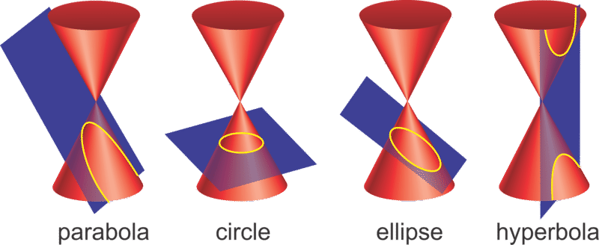
What are Conic Sections?
Geometric definition:
Conic sections are those geometric figures formed by the intersection of a plane and a double cone. They are a “section of the cone.”

Slide 3
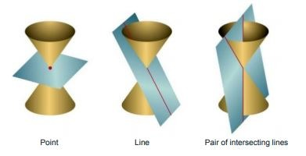
What are Conic Sections?
Geometric definition:
There are 3 degenerate cases which we do not consider

Slide 4
Why do we study them?
Mathematicians have studied them since at least 350 BC
Conic sections have interesting applications
Conic sections have interesting mathematical properties

Slide 5
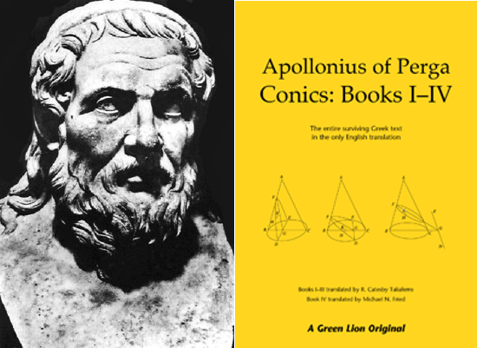
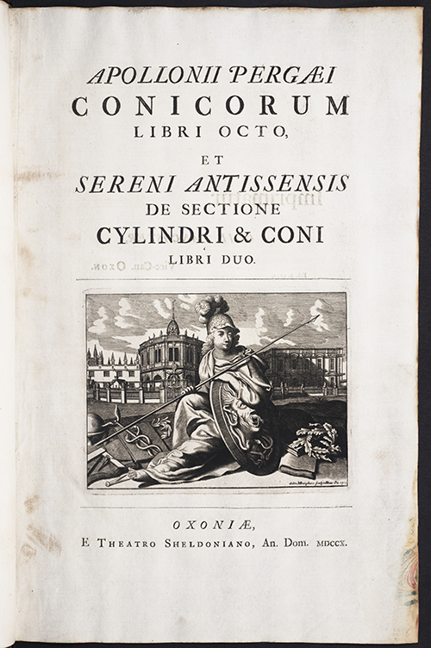
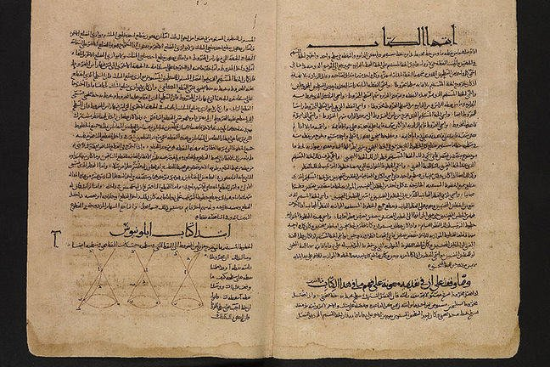
Mathematicians have studied them since at least 350 BC
Various translations of original Greek text by Apollonius of Perga
Apollonius_of_Perga

Slide 6
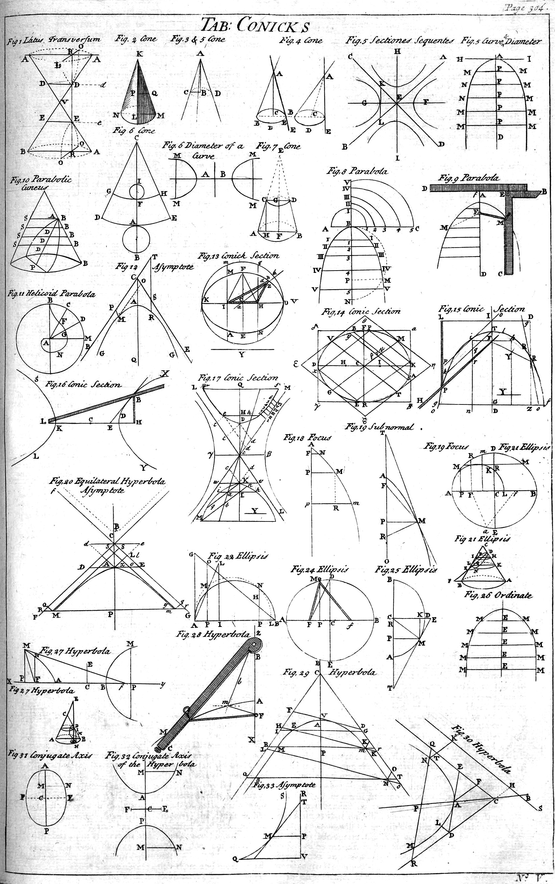
Table of Conics from
Chambers’s Cyclopaedia, a 1728 text
Chamber's Universal_Dictionary_of_Arts_and_Sciences

Slide 7
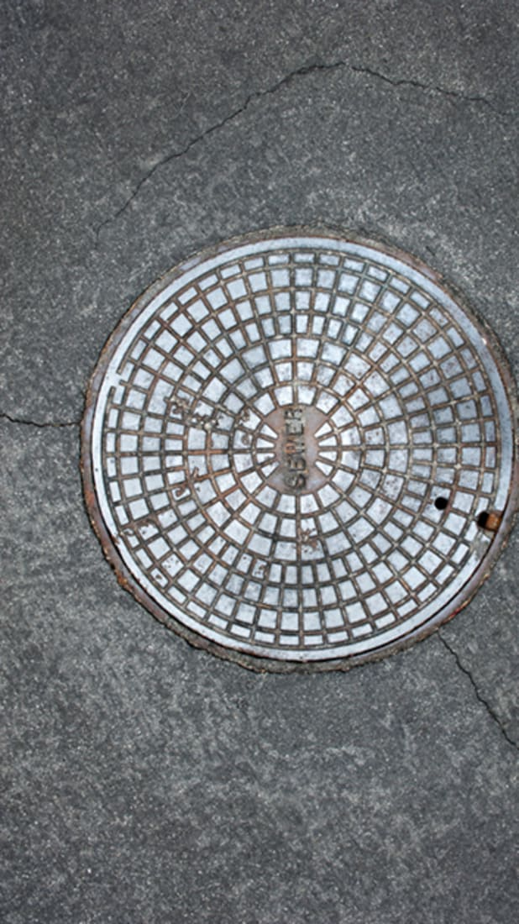
Conic sections have interesting applications
Circles:
Manhole Covers:
are round because “it is the best shape to resist the compression of Earth around it.”
Round shapes are easier to manufacture than square or rectangular shapes,
and because manhole covers are heavy, being round makes them
easier to move from place to place (just roll them!).
As an added benefit, workers don’t need to line up the covers with any angles,
making round covers easy to slip into place.
But perhaps the biggest reason that manhole covers are round is that round covers
can’t fall through a circular opening. “For all manholes, there is a ‘lip’ around the rim
of the hole, holding up the cover, which means that the underlying hole
is smaller than the cover,” Scheckel writes.
“A round manhole cover can’t fall through its circular opening,
because no matter how you position it, the cover is wider than the hole.
But a square, rectangular, or oval manhole cover could fall in
if it was inserted diagonally into the hole,” which would be bad news
for unobservant pedestrians and drivers alike.

Slide 8
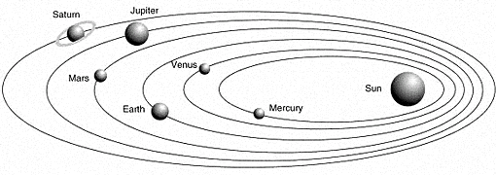
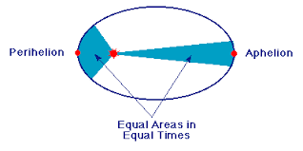
Conic sections have interesting applications
Ellipses:
Johannes Kepler’s (1571 – 1630) laws of planetary motion
1) every planet’s orbit is an ellipse with the Sun at a focus
2) a line joining the Sun and a planet sweeps out equal areas in equal times
3) the square of a planet’s orbital period is proportional to the cube of the semi-major axis of its orbit.

Slide 9
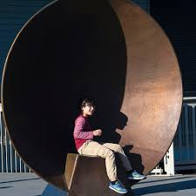
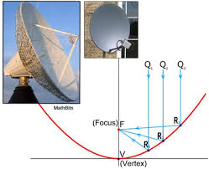
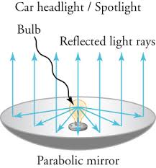
Conic sections have interesting applications
Parabolas
Parabolic shapes have the property that, if they are made of material that reflects light,
then light that travels parallel to the axis of symmetry of a parabola and strikes its concave side
is reflected to its focus, regardless of where on the parabola the reflection occurs.
Conversely, light that originates from a point source at the focus is reflected into a parallel ("collimated") beam,
leaving the parabola parallel to the axis of symmetry. The same effects occur with sound and other waves.
This reflective property is the basis of many practical uses of parabolas.

Slide 10
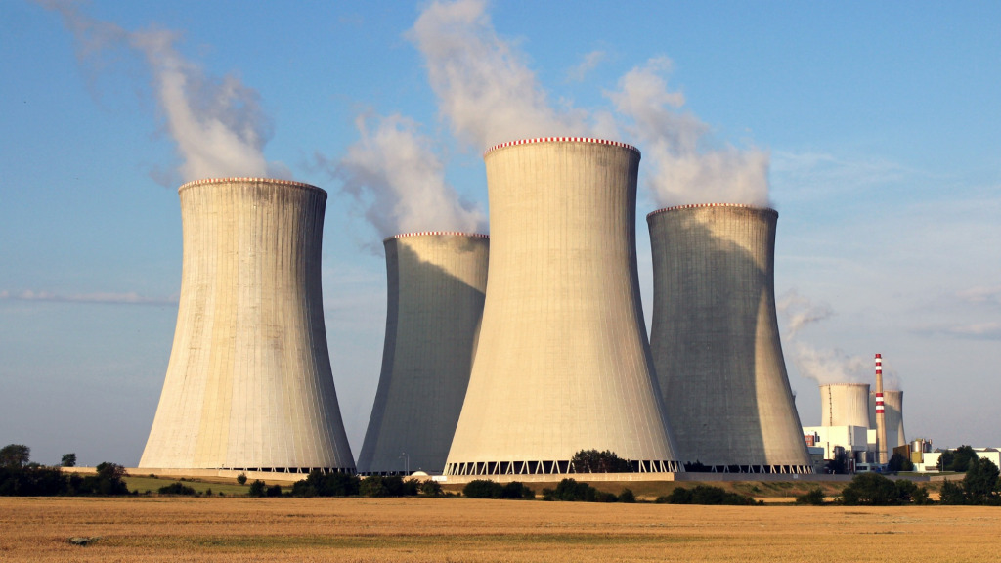
Conic sections have interesting applications
Hyperbolas
Hyperboloid (sometimes incorrectly known as hyperbolic) cooling towers have become the design
standard for all natural-draft cooling towers because of their structural strength and minimum usage of material.
The hyperboloid shape also aids in accelerating the upward convective air flow, improving cooling efficiency.
These designs are popularly associated with nuclear power plants.
However, this association is misleading, as the same kind of cooling towers are often used at
large coal-fired power plants as well.

Slide 11
We can mathematically define conic sections (in the Euclidean plane) in a couple of ways Note: many of the applications of conics come from their 3-dimensional analogs In Math League, we study the 2-dimensional Cartesian planar conics
As a locus of points
Using definitions of distance
Using the idea of eccentricity and distance from focal point to directrix
Algebraically
Conic sections are planar curves that fit the definition
Ax² + Bxy + Cy² + Dx + Ey + F = 0 where A, B, and C not all zero

Slide 12
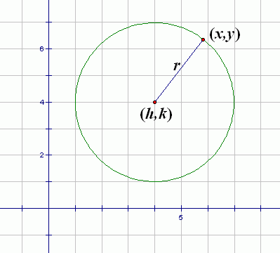
Conic sections as a locus of points
A circle can be defined as all points in a plane a constant distance from a focal point, known as the center of the circle. The constant distance is called the radius of the circle
Some students mistakenly think a circle is
all the points on the circle and inside the circle.
Mathematically speaking, that is incorrect.
A circle consists of all the points on the circle,
not inside.

Slide 13
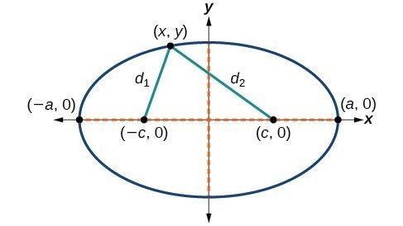
Conic sections as a locus of points
An ellipse can be defined as the curve surrounding two focal points, F₁ and F₂ , such that for all points P on the curve, the sum of the two distances to the focal points is a constant
That is, PF₁+ PF₂ = d₁ + d₂ = constant
P
It will be shown that the constant is 2a
That is, d₁ + d₂ = 2a
F₂
F₁

Slide 14
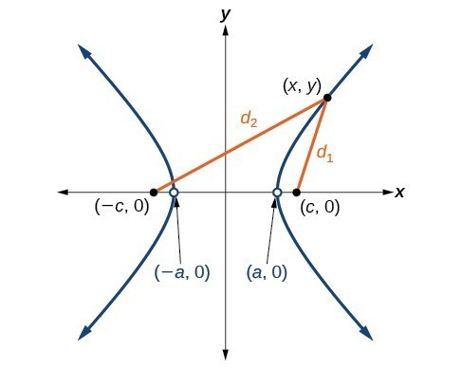
Conic sections as a locus of points
A hyperbola can be defined as the curve created by two focal points, F₁ and F₂ and all points P, such that for all points P on the curve, the absolute differences of the two distances to the focal points is a constant.
That is, | PF₁– PF₂ |= d₁ – d₂ = constant = 2a
P
F₂
F₁

Slide 15
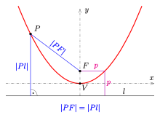
Conic sections as a locus of points
A parabola can be defined as the curve created by focal point F and directrix line l and all points P, such that the distance from P to F is equal to the distance from P to the line l .
That is, PF = Pl

Slide 16
We can mathematically define conic sections (in the Euclidean plane) in a couple of ways Note: many of the applications of conics come from their 3-dimensional analogs In Math League, we study the 2-dimensional Cartesian planar conics
As a locus of points
Using definitions of distance
Using the idea of eccentricity and distance from focal point to directrix
Algebraically
Conic sections are planar curves that fit the definition
Ax² + Bxy + Cy² + Dx + Ey + F = 0 where A, B, and C not all zero

Slide 17
Conic sections as a locus of points Using the idea of eccentricity and distance from focal point to directrix
Define a point F to be the focal point
Define a line L to be the directrix
Define a point P to be on the conic
P is on the conic if the distance FP divided by the distance LP = constant.
That is, $\frac{FP}{LP}=e$
This is constant is known as the eccentricity, e, of the conic.
If e = 0, the conic is a circle (the limiting case of an ellipse)
If 0 < e < 1, the conic is an ellipse
If e = 1, the conic is a parabola
If e > 1, the conic is a hyperbola

Slide 18
Let’s demonstrate how eccentricity can be use to create conics special conic graph paper

Slide 19
Finding a conic using
the idea
of eccentricity
8
6
e = 1/2
4
3
2
4
F₂
F₁
P
F₁P/LP = 1/2
L
Ellipse!
By symmetry, we could have
created the same ellipse
with another focal point and
another directrix

Slide 20
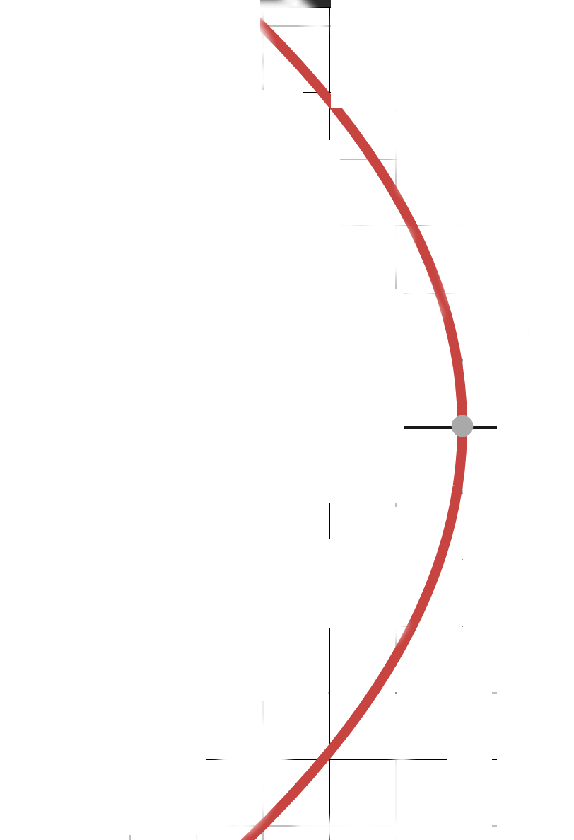
Finding a conic using
the idea
of eccentricity
5
4
5
4
e = 1
3
3
F₁
P
F₁P/LP = 1
L
Parabola!

Slide 21
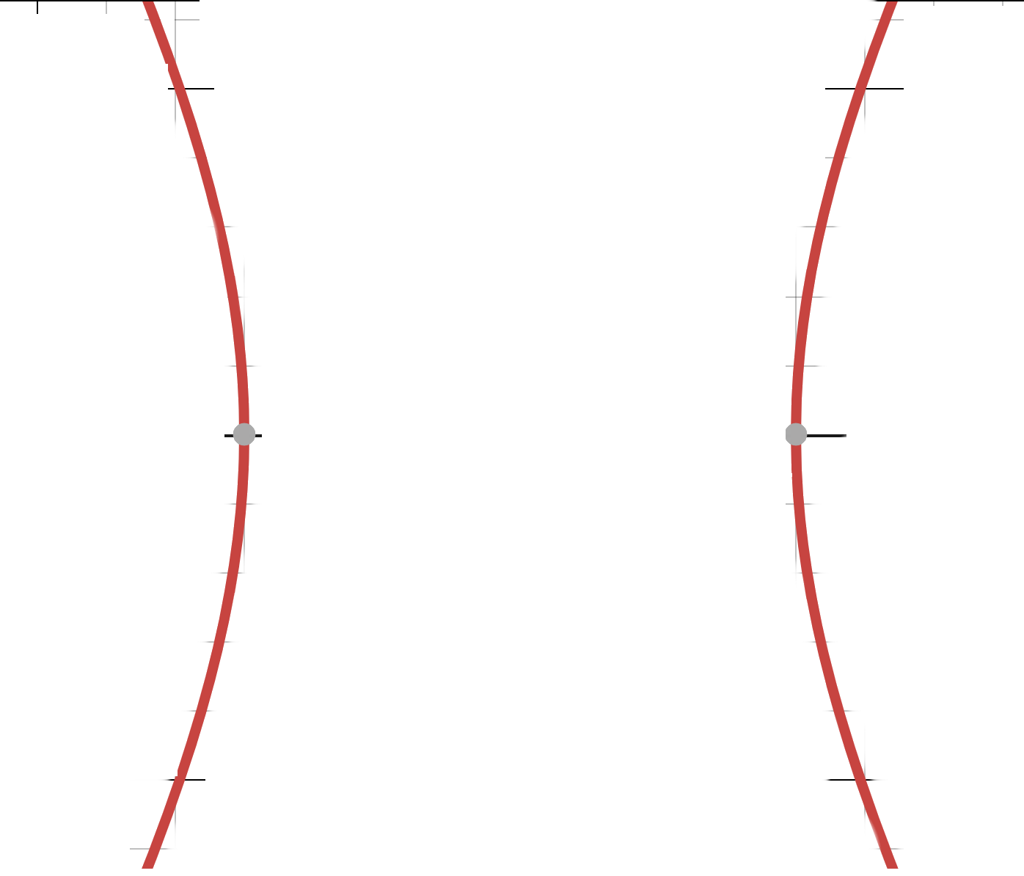
Finding a conic using
the idea
of eccentricity
3
2.5
6.5
6
13
5
e = 2
4
2
12
F₁
P
6
F₁P/LP = 2
L
Hyperbola!
By symmetry, we could have
created the same hyperbola
with another focal point and
another directrix

Slide 22
We can mathematically define conic sections (in the Euclidean plane) in a couple of ways Note: many of the applications of conics come from their 3-dimensional analogs In Math League, we study the 2-dimensional Cartesian planar conics
As a locus of points
Using “common” definitions of distance
Using the idea of eccentricity and distance from focal point to directrix
Algebraically
Conic sections are planar curves that fit the definition
Ax² + Bxy + Cy² + Dx + Ey + F = 0 where A, B, and C not all zero

Slide 23
Algebraic formula from Locus of Points definitions: Circle, center (h,k) “distance from P to Center, O, is constant radius”
Use distance formula
d = $\sqrt{\left(x1−x2\right)2+\left(y1 −y2\right)2}$
r² = $\left(x−h\right)2+\left(y −k\right)2$
r² = $\left(x2 −2hx+h2\right)+\left(y2 −2ky+k2\right)$
0 = $\left(x2+y2−2hx –2ky+h2+k2 −r2\right)$
0 = $x2+y2−2hx –2ky+h2+k2 −r2$
0 = A$x2+Bxy+Cy2+Dx+Ey+F$
where A = 1, B = 0, C = 1, D = –2h, E = –2k F = $h2+k2 −r2$
P
O

Slide 24
Potential math team problem
All conics can be expressed algebraically as
0 = A$x2+Bxy+Cy2+Dx+Ey+F$
Do so for a circle centered at (5,1) with a radius of 4
Solution 1: write out vertex form of a circle and do the algebra
4² = $\left(x−5\right)2+\left(y −1\right)2$
16 = $\left(x2 −10x+25\right)+\left(y2 −2y+1\right)$
0 = $x2+y2−10x –2y+10$
Solution 2: memorize the A, B, C, D, E, F values
A = 1, B = 0, C = 1, D = –2h, E = –2k F = $h2+k2 −r$
0 = 1$x2+1y2−10x –2y+10$

Slide 25
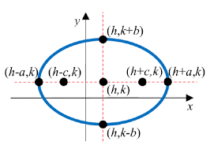
Algebraic formula from Locus of Points definition : Ellipse (center at (h,k)) “the sum of the distances from P to the focal points is constant”
Use distance formula to find PF₁ + PF₂ = 2a
d = $\sqrt{\left(x1−x2\right)2+\left(y1 −y2\right)2}$
2a = $\sqrt{\left(x−(h−c)\right)2+\left(y −k\right)2}$ + $\sqrt{\left(x−(h+c)\right)2+\left(y −k\right)2}$
4a² = $\left(x−(h−c)\right)2+\left(y −k\right)2$+ $\left(x−(h+c)\right)2+\left(y −k\right)2$
+ 2$\sqrt{\left(x−(h−c)\right)2+\left(y −k\right)2}$ $\sqrt{\left(x−(h+c)\right)2+\left(y −k\right)2}$
gets crazy difficult, and where did the 2a come from?!
P
(x,y)
F₁
F₂

Slide 26
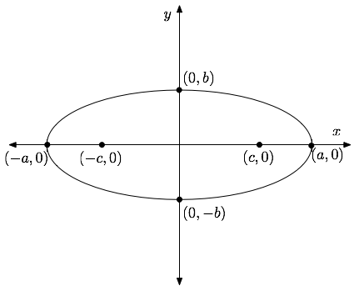
Algebraic formula from Locus of Points definitions: Ellipse (center (0,0)) “the sum of the distances from P to the focal points is constant”
The blue distance is c + a
The red distance is a – c
a
We’ve established that d₁ + d₂ = 2a
d₁
d₁
d₂
d₂
b
d₁
d₁
d₂
c
d₂
It follows that d₂ = a where positioned
We can see that c² + b² = a²
or c² = a² – b²

Slide 27
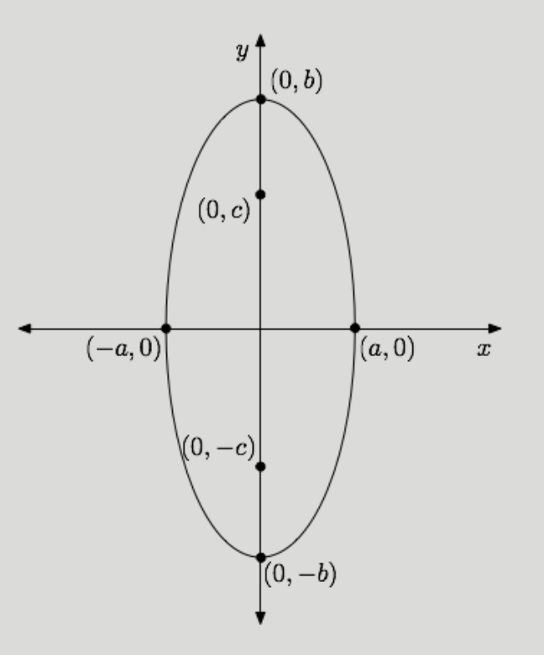
Algebraic formula from Locus of Points definitions: Ellipse (center (0,0)) “the sum of the distances from P to the focal points is constant”
A similar argument can show that d₁ + d₂ = 2b
We can see that c² + a² = b²
or c² = b² – a²
d₁
b
c
a
From previous slide c² + b² = a²
or c² = a² – b²
d₂
This fact is necessary for the next proof
c² = |a² – b²|

Slide 28
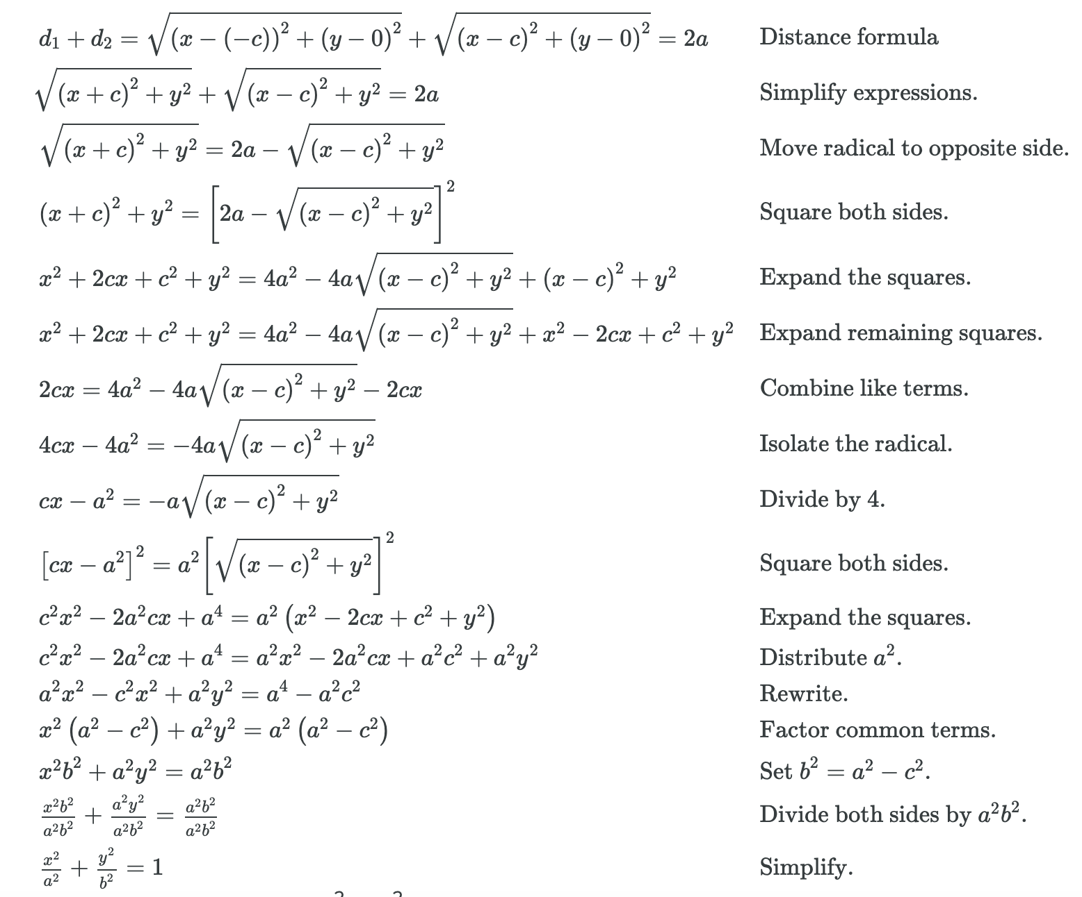
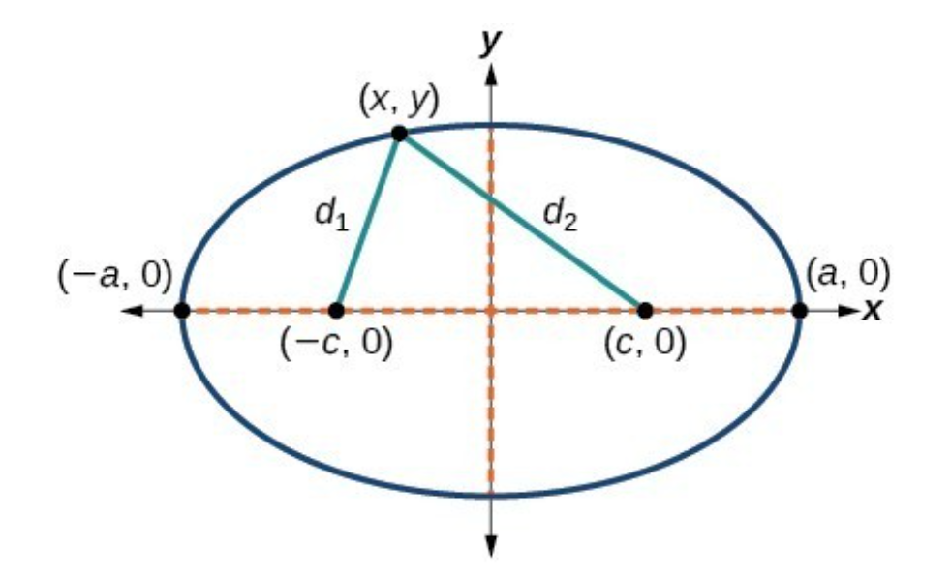
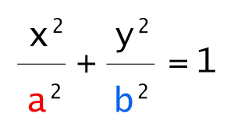
Algebraic formula from Locus of Points definitions: Ellipse (center (0,0)) “the sum of the distances from P to the focal points is constant”
(0,b)
(0,–b)

Slide 29
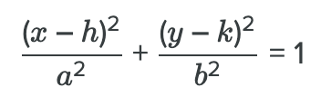
Algebraic formula from Locus of Points definitions: Ellipse (center (h,k))
Translation

Slide 30
Finding Algebraic formulas from Locus of Points definitions
Ellipse: showing it is of the form 0 = A$x2+Bxy+Cy2+Dx+Ey+F$
$\frac{x2 −2xh+h2}{a2}$ + $\frac{y2 −2yk+k2}{b2}$ = 1
b²($x2 −2xh+h2$)+ $a2(y2 −2yk+k2$) = a²b²
b²$x2 \text{+ }a2y2−2x\text{b}\text{2}h$ $−2ya2k+a2k2$ – a²b² + $\text{b}\text{2}h2$= 0

Slide 31
Potential math league problem
Given the ellipse 2$x2+8y2+4x+24y+8$ = 0 find the center
Solve by completing the square
2(x² + 2x ) + 8(y² + 3y) = – 8
2(x² + 2x + 1) + 8(y² + 3y + 2.25) = – 8 + 20 = 12
$\frac{(x+1)2}{6}$ + $\frac{(y+1.5)2}{1.5}$ = 1
Center is at (–1, –1.5)

Slide 32
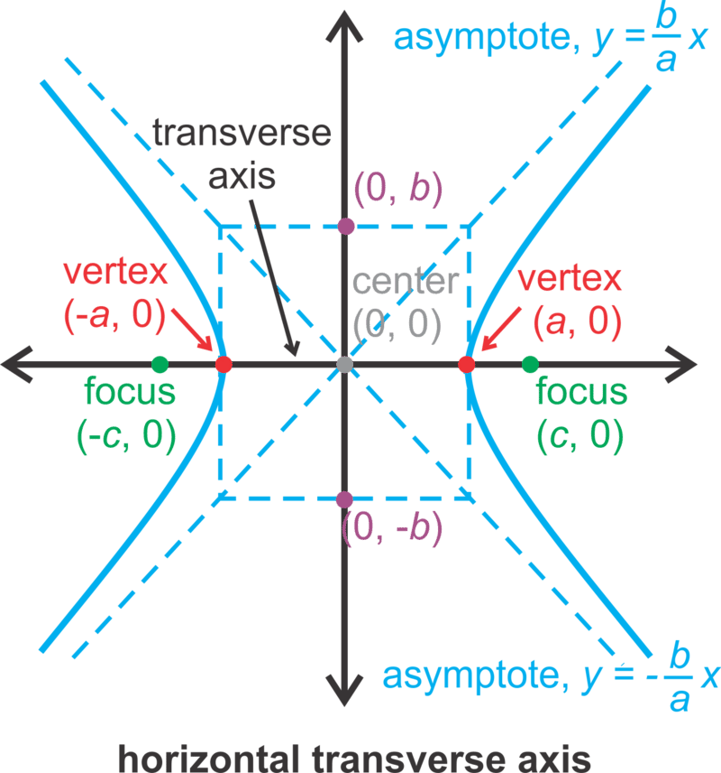
Algebraic formula from Locus of Points: Hyperbola (center (0,0)) “the absolute difference of the distances from P to F₁ and F₂ is a constant”
P
It can be shown that | d₁ – d₂ | = 2a
d₁
d₂
One argument is that Vertex to Focus = c – a
and Vertex to other Focus = a + c
(a + c) – (c – a) = 2a
And therefore this must hold for all points
It can also be shown that c² = a² + b²
Watch Khan Academy video at
proof that c^2 = a^2 + b^2

Slide 33
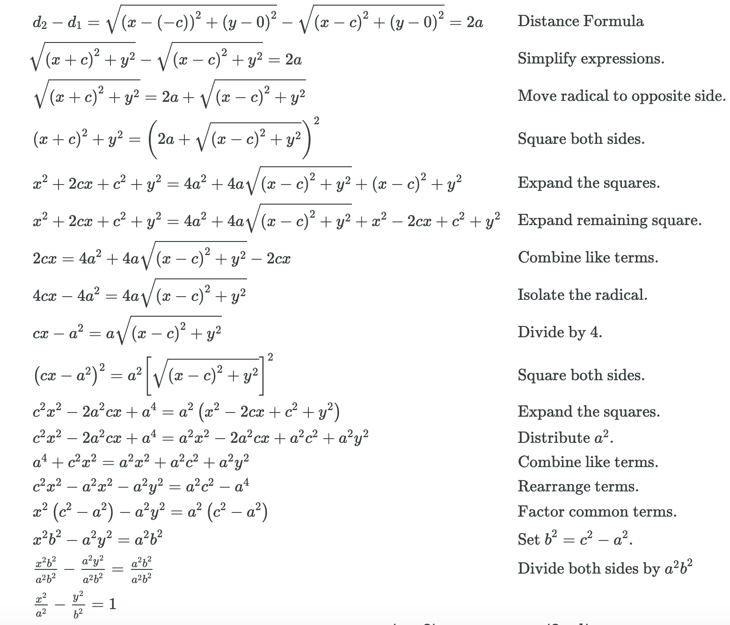
Algebraic formula from Locus of Points: Hyperbola (center (0,0)) “the absolute difference of the distances from P to F₁ and F₂ is a constant”

Slide 34
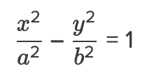
Algebraic formula from Locus of Points: Hyperbola (center (0,0)) “the absolute difference of the distances from P to F₁ and F₂ is a constant”

Slide 35
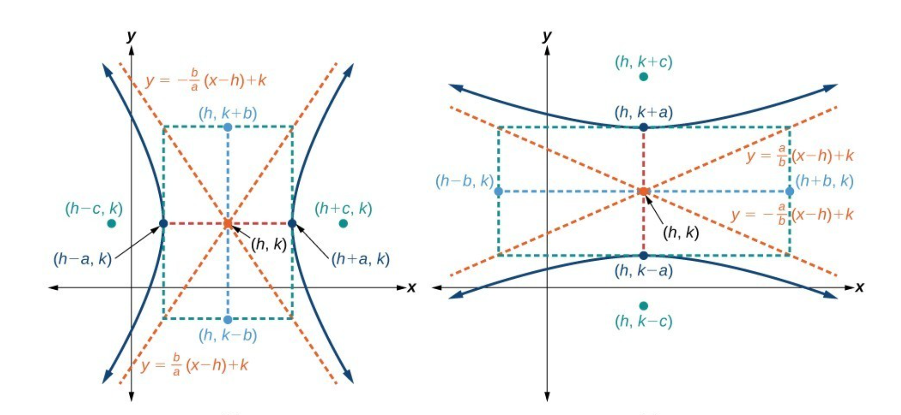
Algebraic formula from Locus of Points: Hyperbola (center (h,k)) “the absolute difference of the distances from P to F₁ and F₂ is a constant”
appeal to translating by h,k

Slide 36
Algebraic formula from Locus of Points: Hyperbola (center (h,k)) “the absolute difference of the distances from P to F₁ and F₂ is a constant”
Which way is it oriented?
Whatever “comes first” (i.e. is the larger quantity) in the subtraction
$\frac{(x−3)2}{16}$ – $\frac{(y−1)2}{9}$ = 1 opens in the x direction left and right
$\frac{(y−1)2}{9}$ – $\frac{(x−3)2}{16}$ = 1 opens in the y direction up and down

Slide 37
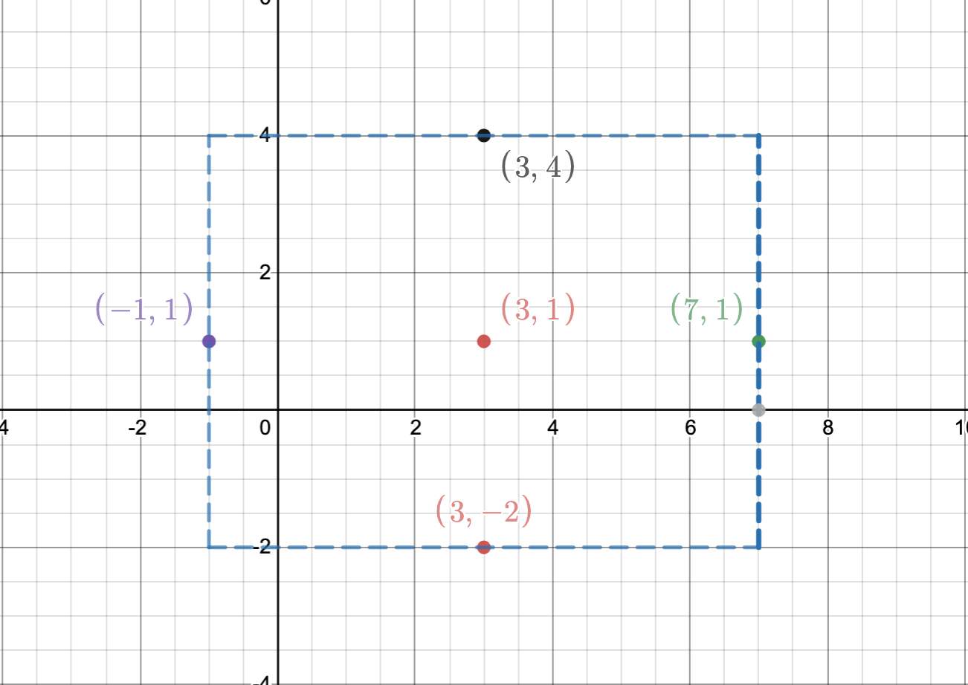
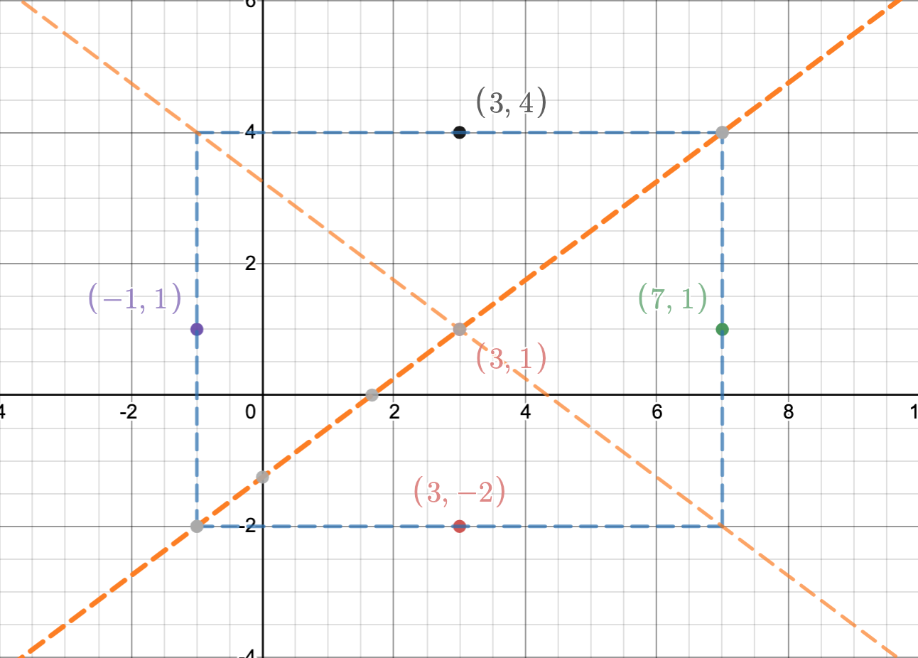
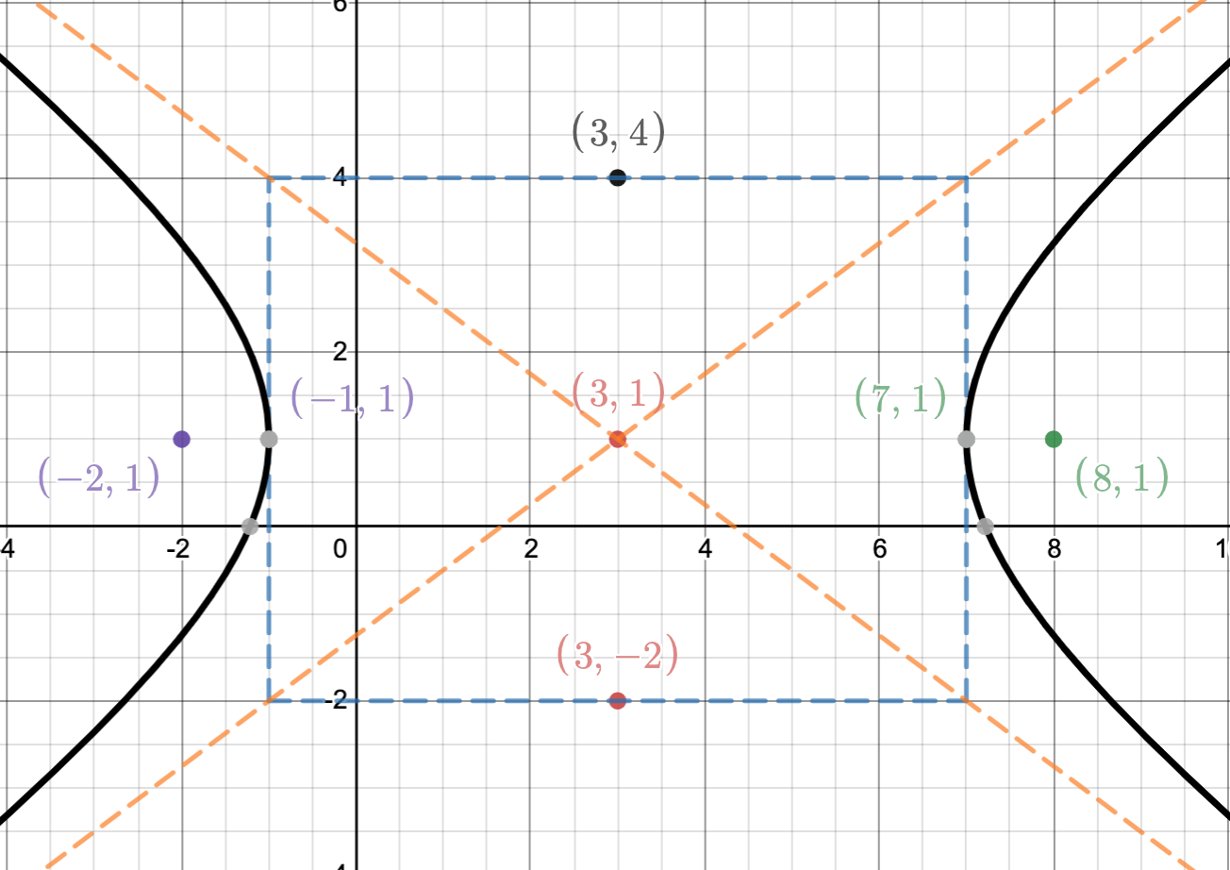
Algebraic formula from Locus of Points: Hyperbola (center (h,k)) “the absolute difference of the distances from P to F₁ and F₂ is a constant”
It’s all about
the rectangle
$\frac{(x−3)2}{16}$ – $\frac{(y−1)2}{9}$ = 1
Center (3,1)
4 wide 3 high
Vertices (7,1) and (-1,1)
draw in asymptotes
Where are the foci?
c² = a² + b² c = 5
(8,1) (-2,1)
Draw in hyperbola

Slide 38
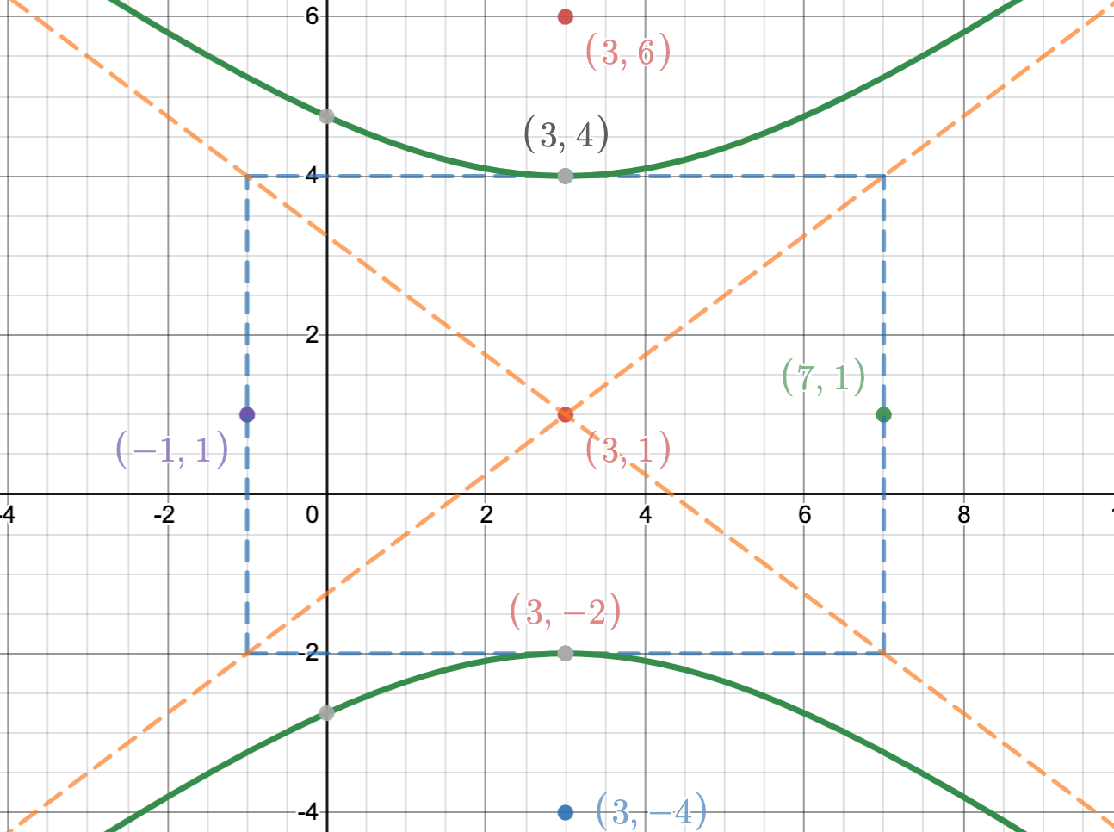
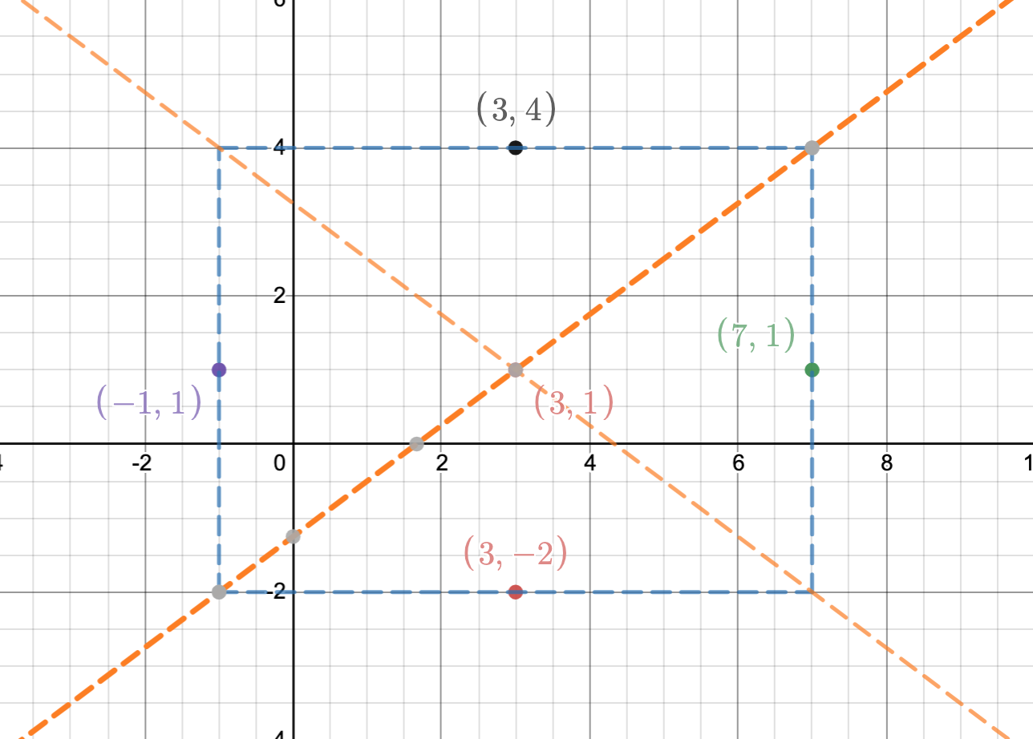
Algebraic formula from Locus of Points: Hyperbola (center (h,k)) “the absolute difference of the distances from P to F₁ and F₂ is a constant”
It’s all about
the rectangle
$\frac{(y−1)2}{9}$ – $\frac{(x−3)2}{16}$ = 1
Center (3,1)
4 wide 3 high
Vertices (3,4) and 3,–2)
draw in asymptotes
Where are the foci?
c² = a² + b² c = 5
(3,6) (3,-4)
Draw in hyperbola

Slide 39
How do I know which way an ellipse or a hyperbola is oriented??
“Follow the foci”

Slide 40
How do I know which way an ellipse or a hyperbola is oriented??
“Follow the foci”
Ellipse: foci at (4, 5) and (4, 11) Notice they are vertically aligned taller
Ellipse: foci at (4, 5) and (12, 5) Notice they are horizontally aligned wider
Hyperbola: foci at (3,5) and (7,5) Notice they are horizontally aligned opens left and right
Hyperbola: foci at (3,5) and (3,10) Notice they are vertically aligned opens up and down
The same could be said about following the vertices

Slide 41
Algebraic formula from Locus of Points definitions: Parabola (focus at (a,b)) “the distances from P to the focal points is equal to the distance from P to the directrix”

Slide 42
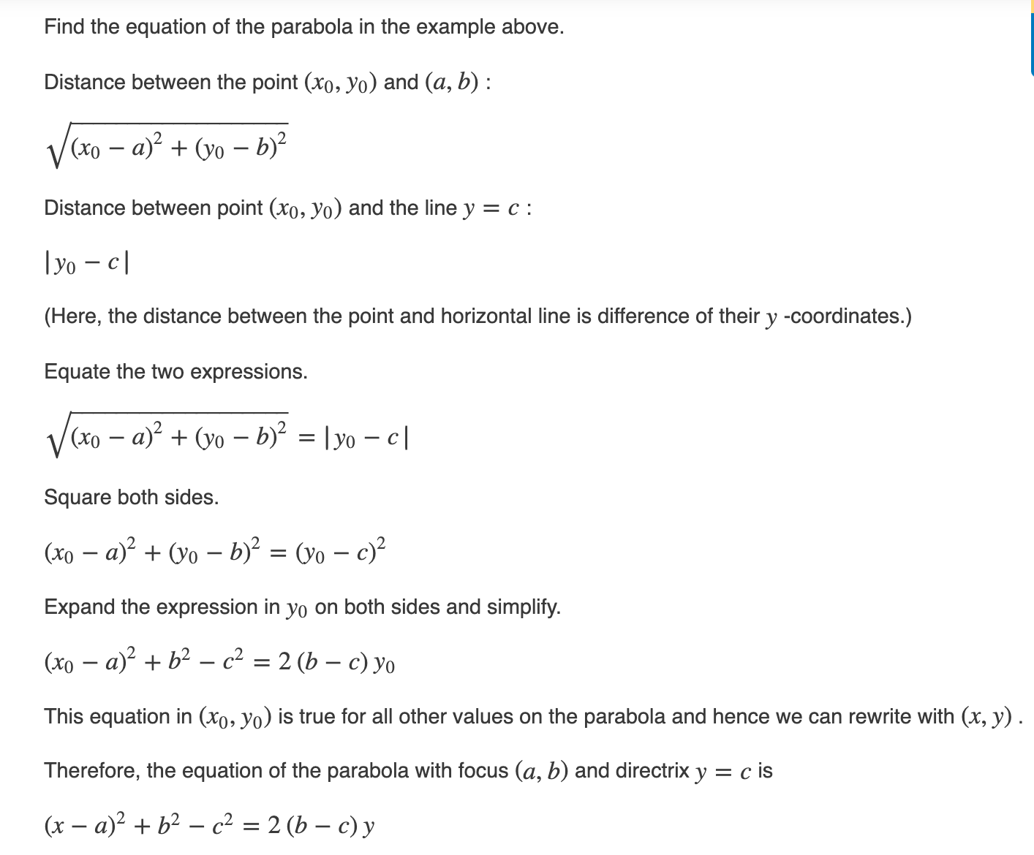
Algebraic formula from Locus of Points definitions: Parabola (focus at (a,b)) “the distances from P to the focal points is equal to the distance from P to the directrix”
Directrix at y = c

Slide 43
Potential math team problem ( is there another way? )
Find the equation of a parabola with focus at (–1, 3) and directrix at y = 5
(x – –1 )²+ 3² – 5² = 2(3 – 5)y
(x + 1)² – 16 = –4y
$\frac{−\left(x+1\right)2}{4}+4$ = y

Slide 44
Recognizing the different conics from their algebraic definition
Ax² + Bxy + Cy² + Dx + Ey + F = 0 General form
In concert with the other terms, the term Bxy does weird things to the graphs:
it can make the conic slanted (x² – 7xy + 13y² = 4),
it can cause the graph to degenerate to a line (x² – 2xy + y² = 0),
it can create two || lines (x² – 2xy + y² = 4),
it can create intersecting lines (x² – 4xy + y² = 0),
it can cause what you think is an ellipse to be a hyperbola (x² – 7xy + 2y² = 4)
hard to predict based on the interactions with the other terms.
So for this discussion, we are going to assume B = 0. Math League rarely uses conics with a B value but we will show a couple of examples later

Slide 45
Recognizing the different conics from their algebraic definition
Ax² + Cy² + Dx + Ey + F = 0 General form, where B = 0
If A = C = 0 and D, E not both zero, the graph is a line
If A = C, the graph is a usually a circle (degenerate cases can occur depending on D, E, F… e.g x² + y² + 8 = 0)
If A ≠ C, and A and C have the same sign, the graph is a usually an ellipse
(degenerate cases can occur depending on D, E, F… e.g x² +5y² -x+y+3=0)
If A ≠ C,and A and C have the different signs, the graph is a usually a hyperbola
(degenerate cases can occur depending on D, E, F… e.g x² + 20x + 100 – y² = 0)
If A or C = 0 (but not both), the graph is a parabola (I am not aware of degenerate cases)

Slide 46
Potential problems: Recognizing the different conics from their algebraic definition
Knowing that the following is a conic, what type (circle, ellipse, hyperbola, parabola) is it?
A. 5x + 7y – 9 + y² = 0
B. 5x² + 7y – 9x – y² = 0
C. 5x² + 7y – 9x + 5y² = 0
D. 5x² + 7y – 9x + 3y² = 0

Slide 47
Potential problems: Recognizing the different conics from their algebraic definition
Knowing that the following is a conic, what type (circle, ellipse, hyperbola, parabola) is it?
A. 5x + 7y – 9 + y² = 0 parabola
B. 5x² + 7y – 9x – y² = 0 hyperbola
C. 5x² + 7y – 9x + 5y² = 0 circle
D. 5x² + 7y – 9x + 3y² = 0 ellipse

Slide 48
This is the end of part one
In separate PowerPoints, we will examine each conic separately, working on the details of each particular conic and doing more examples from the Math League canon

