Slide 1
A Primer on Conic Sections part five Hyperbolas
Presented at the MN State HS Mathematics League
Coaches Conference
October 3rd, 2020
by
Tom Young, Executive Director

Slide 2
What are Hyperbolas?
Geometric definition:
Hyperbolas are those geometric figures formed by the intersection of a plane and a double cone. The plane is parallel to the heights of the cones.

Slide 3
Why do we study them?
Mathematicians have studied them since at least 350 BC
Conic sections have interesting applications
Conic sections have interesting mathematical properties

Slide 4
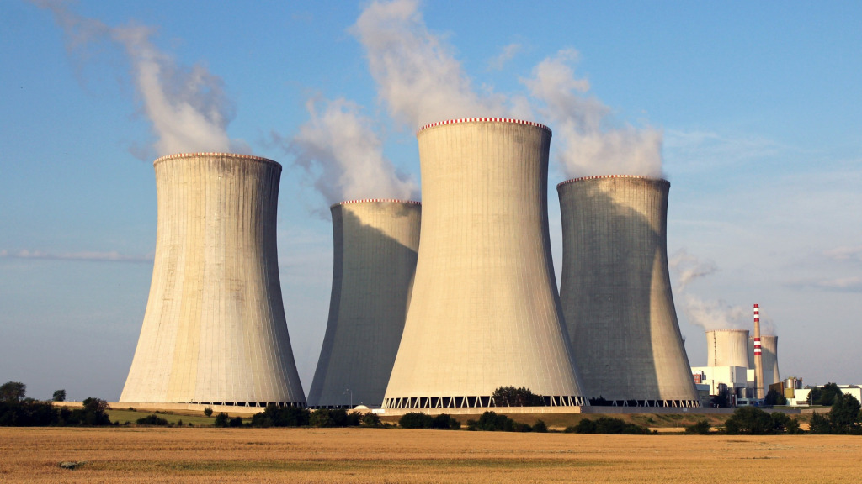
Conic sections have interesting applications
Hyperbolas
Hyperboloid (sometimes incorrectly known as hyperbolic) cooling towers have become the design
standard for all natural-draft cooling towers because of their structural strength and minimum usage of material.
The hyperboloid shape also aids in accelerating the upward convective air flow, improving cooling efficiency.
These designs are popularly associated with nuclear power plants.
However, this association is misleading, as the same kind of cooling towers are often used at
large coal-fired power plants as well.

Slide 5
We can mathematically define conic sections (in the Euclidean plane) in a couple of ways Note: many of the applications of conics come from their 3-dimensional analogs In Math League, we study the 2-dimensional Cartesian planar conics
As a locus of points
Using definitions of distance
Using the idea of eccentricity and distance from focal point to directrix
Algebraically
Conic sections are planar curves that fit the definition
Ax² + Bxy + Cy² + Dx + Ey + F = 0 where A, B, and C not all zero

Slide 6
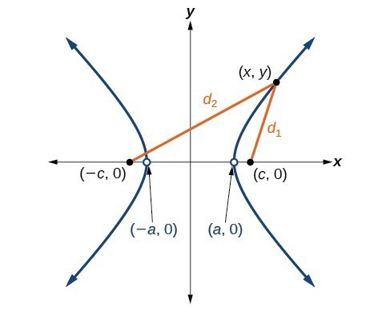
Conic sections as a locus of points
A hyperbola can be defined as the curve created by two focal points, F₁ and F₂ and all points P, such that for all points P on the curve, the absolute differences of the two distances to the focal points is a constant.
That is, | PF₁– PF₂ |= d₁ – d₂ = constant = 2a
P
F₂
F₁

Slide 7
We can mathematically define conic sections (in the Euclidean plane) in a couple of ways Note: many of the applications of conics come from their 3-dimensional analogs In Math League, we study the 2-dimensional Cartesian planar conics
As a locus of points
Using definitions of distance
Using the idea of eccentricity and distance from focal point to directrix
Algebraically
Conic sections are planar curves that fit the definition
Ax² + Bxy + Cy² + Dx + Ey + F = 0 where A, B, and C not all zero

Slide 8
Conic sections as a locus of points Using the idea of eccentricity and distance from focal point to directrix
Define a point F to be the focal point
Define a line L to be the directrix
Define a point P to be on the conic
P is on the conic if the distance FP divided by the distance LP = constant.
That is, $\frac{FP}{LP}=e$
This is constant is known as the eccentricity, e, of the conic.
If e = 0, the conic is a circle (the limiting case of an ellipse)
If 0 < e < 1, the conic is an ellipse
If e = 1, the conic is a parabola
If e > 1, the conic is a hyperbola

Slide 9
Let’s demonstrate how eccentricity can be use to create conics special conic graph paper

Slide 10
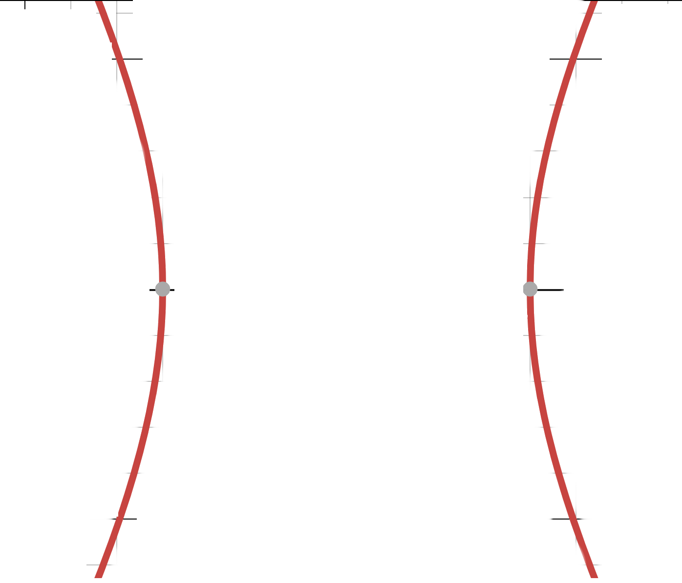
Finding a hyperbola
using
the idea
of eccentricity
3
2.5
6.5
6
13
5
e = 2
4
2
12
F₁
P
6
F₁P/LP = 2
L
Hyperbola!
By symmetry, we could have
created the same hyperbola
with another focal point and
another directrix

Slide 11
We can mathematically define conic sections (in the Euclidean plane) in a couple of ways Note: many of the applications of conics come from their 3-dimensional analogs In Math League, we study the 2-dimensional Cartesian planar conics
As a locus of points
Using “common” definitions of distance
Using the idea of eccentricity and distance from focal point to directrix
Algebraically
Conic sections are planar curves that fit the definition
Ax² + Bxy + Cy² + Dx + Ey + F = 0 where A, B, and C not all zero

Slide 12
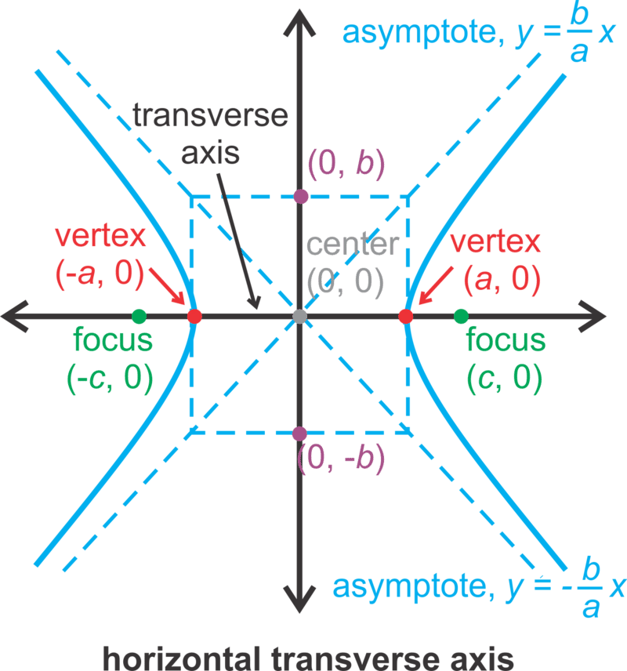
Algebraic formula from Locus of Points: Hyperbola (center (0,0)) “the absolute difference of the distances from P to F₁ and F₂ is a constant”
P
It can be shown that | d₁ – d₂ | = 2a
d₁
d₂
One argument is that Vertex to Focus = c – a
and Vertex to other Focus = a + c
(a + c) – (c – a) = 2a
And therefore this must hold for all points
It can also be shown that c² = a² + b²
Watch Khan Academy video at
proof that c^2 = a^2 + b^2

Slide 13
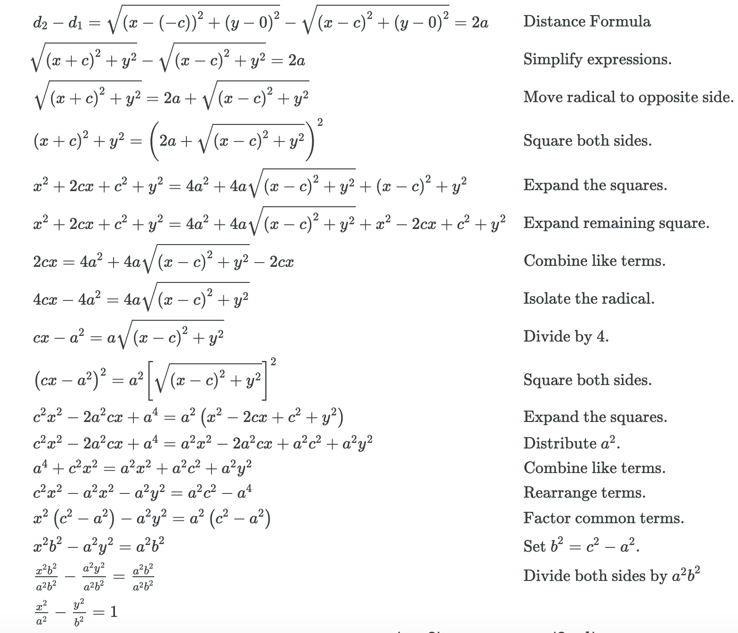
Algebraic formula from Locus of Points: Hyperbola (center (0,0)) “the absolute difference of the distances from P to F₁ and F₂ is a constant”

Slide 14
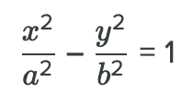
Algebraic formula from Locus of Points: Hyperbola (center (0,0)) “the absolute difference of the distances from P to F₁ and F₂ is a constant”

Slide 15
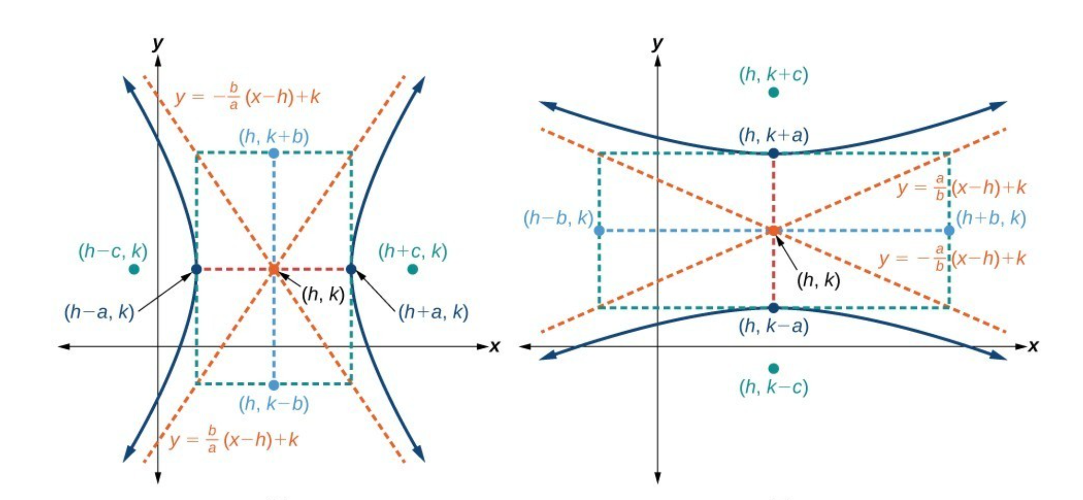
Algebraic formula from Locus of Points: Hyperbola (center (h,k)) “the absolute difference of the distances from P to F₁ and F₂ is a constant”
appeal to translating by h,k

Slide 16
Algebraic formula from Locus of Points: Hyperbola (center (h,k)) “the absolute difference of the distances from P to F₁ and F₂ is a constant”
Which way is it oriented?
Whatever “comes first” (i.e. is the larger quantity) in the subtraction
$\frac{(x−3)2}{16}$ – $\frac{(y−1)2}{9}$ = 1 opens in the x direction left and right
$\frac{(y−3)2}{9}$ – $\frac{(x−1)2}{16}$ = 1 opens in the y direction up and down

Slide 17
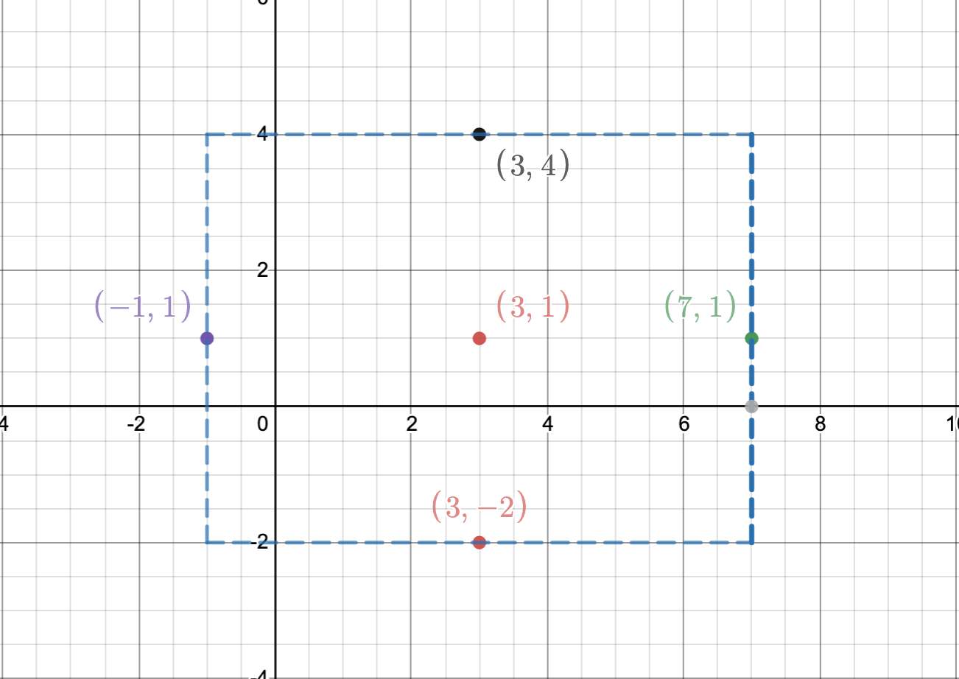
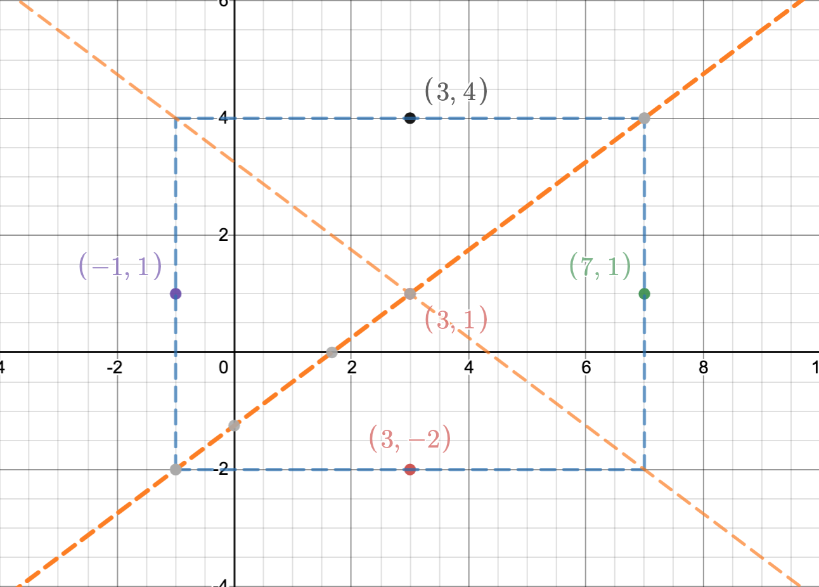
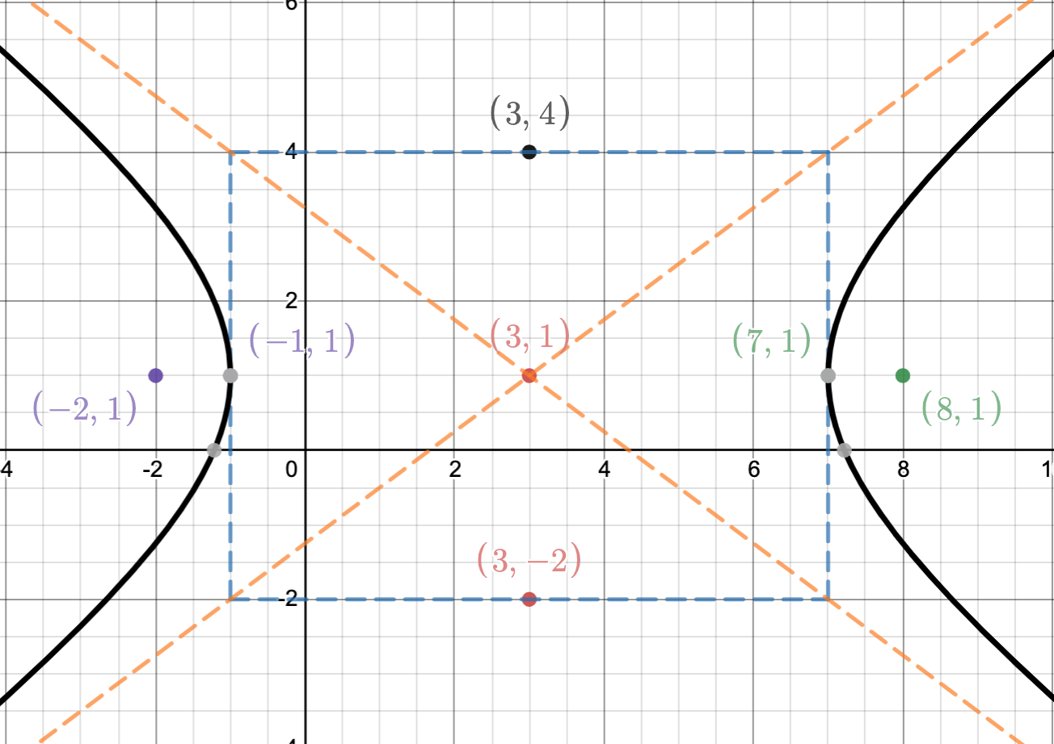
Algebraic formula from Locus of Points: Hyperbola (center (h,k)) “the absolute difference of the distances from P to F₁ and F₂ is a constant”
It’s all about
the rectangle
$\frac{(x−3)2}{16}$ – $\frac{(y−1)2}{9}$ = 1
Center (3,1)
4 wide 3 high
Vertices (7,1) and (-1,1)
draw in asymptotes
Where are the foci?
c² = a² + b² c = 5
(8,1) (-2,1)
Draw in hyperbola

Slide 18
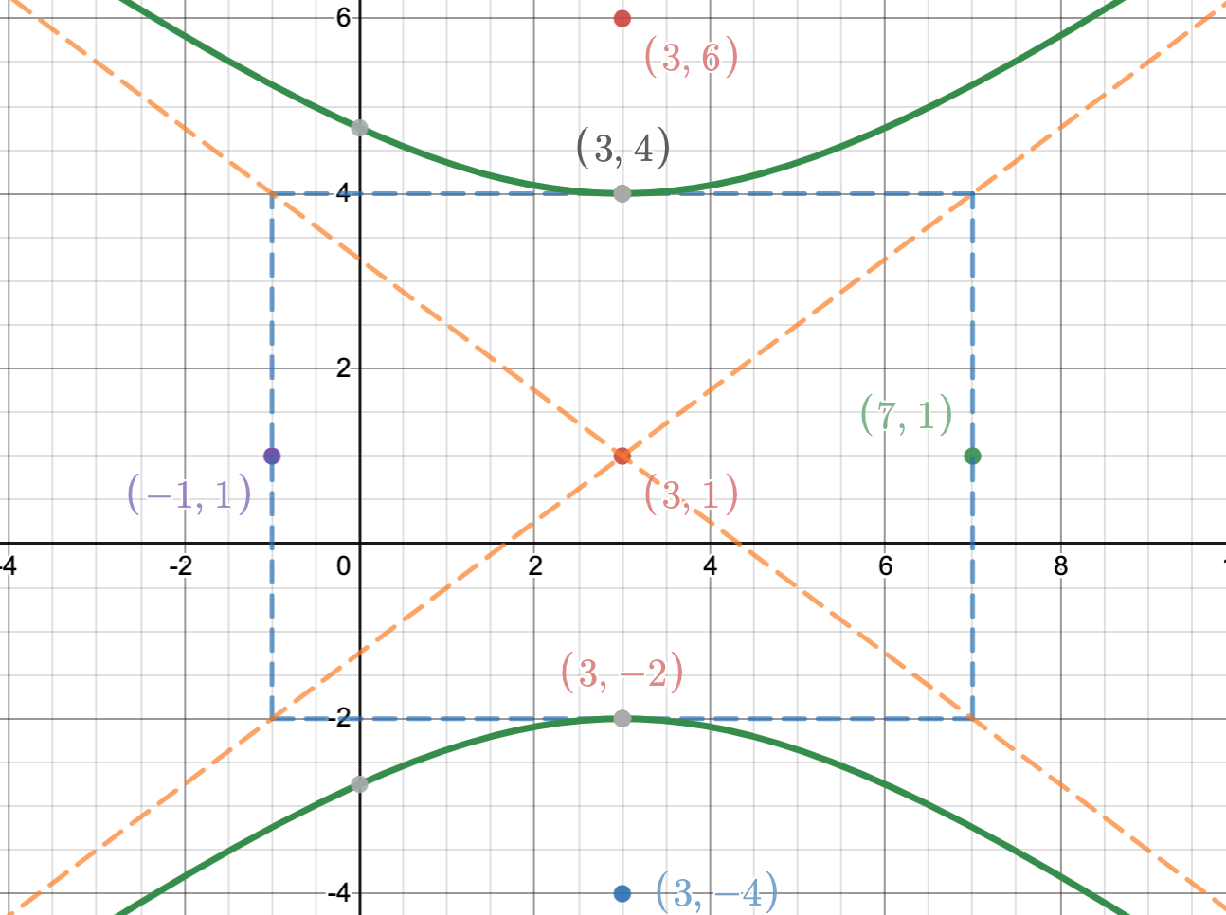
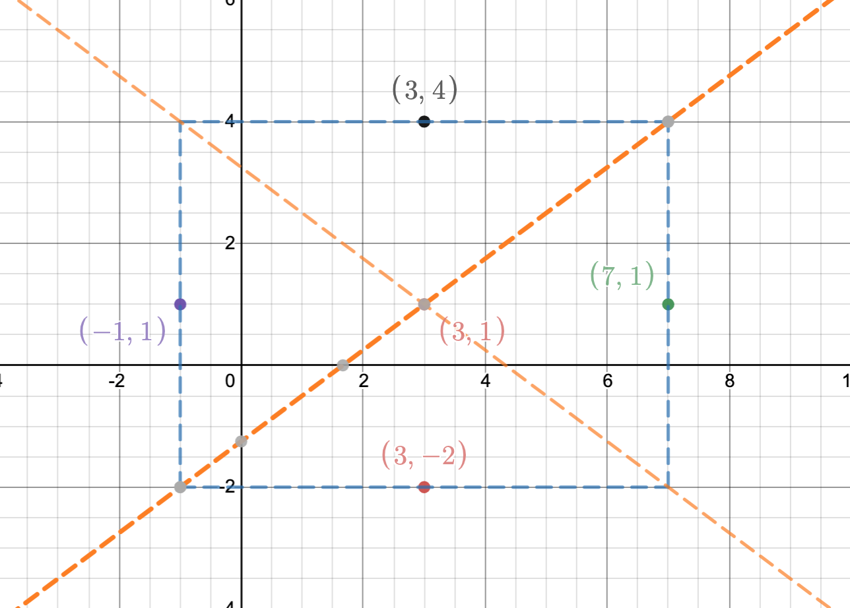
Algebraic formula from Locus of Points: Hyperbola (center (h,k)) “the absolute difference of the distances from P to F₁ and F₂ is a constant”
It’s all about
the rectangle
$\frac{(y−1)2}{9}$ – $\frac{(x−3)2}{16}$ = 1
Center (3,1)
4 wide 3 high
Vertices (3,4) and 3,–2)
draw in asymptotes
Where are the foci?
c² = a² + b² c = 5
(3,6) (3,-4)
Draw in hyperbola

Slide 19
Recognizing the different conics from their algebraic definition
Ax² + Bxy + Cy² + Dx + Ey + F = 0 General form
In concert with the other terms, the term Bxy does weird things to the graphs:
it can make the conic slanted (x² – 7xy + 13y² = 4),
it can cause the graph to degenerate to a line (x² – 2xy + y² = 0),
it can create two || lines (x² – 2xy + y² = 4),
it can create intersecting lines (x² – 4xy + y² = 0),
it can cause what you think is an ellipse to be a hyperbola (x² – 7xy + 2y² = 4)
hard to predict based on the interactions with the other terms.
So for this discussion, we are going to assume B = 0. Math League rarely uses conics with a B value but we will show a couple of examples later

Slide 20
Recognizing the different conics from their algebraic definition
Ax² + Cy² + Dx + Ey + F = 0 General form, where B = 0
If A = C = 0 and D, E not both zero, the graph is a line
If A = C, the graph is a usually a circle (degenerate cases can occur depending on D, E, F… e.g x² + y² + 8 = 0)
If A ≠ C, and A and C have the same sign, the graph is a usually an ellipse
(degenerate cases can occur depending on D, E, F… e.g x² +5y² -x+y+3=0)
If A ≠ C,and A and C have the different signs, the graph is a usually a hyperbola
(degenerate cases can occur depending on D, E, F… e.g x² + 20x + 100 – y² = 0)
If A or C = 0 (but not both), the graph is a parabola (I am not aware of degenerate cases)

Slide 21
Hyperbolas from the last 20+ years of MathLeague
2009 – 2010 #3 and #4
2010 – 2011 #1
2012 – 2013 #1
2017 – 2018 #2
2018 – 2019 #2

Slide 22
Hyperbolas from the last 20+ years of MathLeague
2009 – 2010 #3 and #4

Slide 23
Hyperbolas from the last 20+ years of MathLeague
2009 – 2010 #3 and #4

Slide 24
Hyperbolas from the last 20+ years of MathLeague
2009 – 2010 #3 and #4

Slide 25
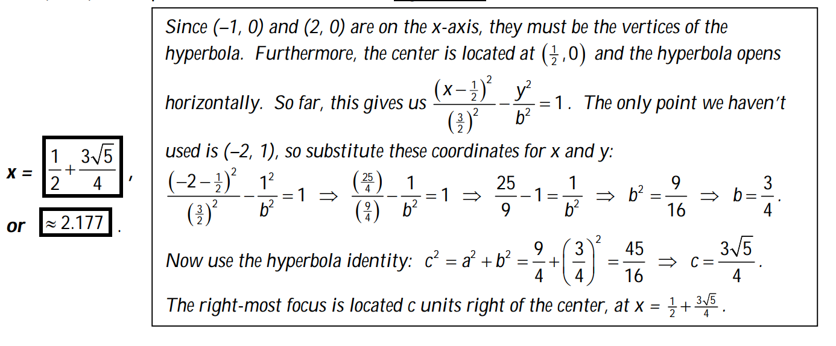
Hyperbolas from the last 20+ years of MathLeague
2009 – 2010 #3 and #4

Slide 26
This is the end of part five
In separate PowerPoints, we will examine each conic separately, working on the details of each particular conic and doing more examples from the Math League canon

