Slide 1
A Primer on Conic Sections part four Parabolas
Presented at the MN State HS Mathematics League
Coaches Conference
October 3rd, 2020
by
Tom Young, Executive Director

Slide 2
What are parabolas?
Geometric definition:
Parabolas are those geometric figures formed by the intersection of a plane and a double cone. The plane intersects only one nappe of the double cone and does not form a closed curve.

Slide 3
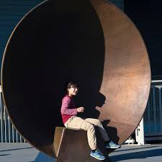
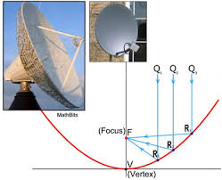
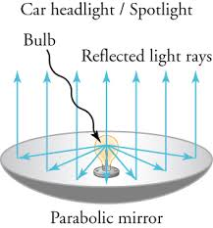
Conic sections have interesting applications
Parabolas
Parabolic shapes have the property that, if they are made of material that reflects light,
then light that travels parallel to the axis of symmetry of a parabola and strikes its concave side
is reflected to its focus, regardless of where on the parabola the reflection occurs.
Conversely, light that originates from a point source at the focus is reflected into a parallel ("collimated") beam,
leaving the parabola parallel to the axis of symmetry. The same effects occur with sound and other waves.
This reflective property is the basis of many practical uses of parabolas.

Slide 4
We can mathematically define conic sections (in the Euclidean plane) in a couple of ways Note: many of the applications of conics come from their 3-dimensional analogs In Math League, we study the 2-dimensional Cartesian planar conics
As a locus of points
Using definitions of distance
Using the idea of eccentricity and distance from focal point to directrix
Algebraically
Conic sections are planar curves that fit the definition
Ax² + Bxy + Cy² + Dx + Ey + F = 0 where A, B, and C not all zero

Slide 5
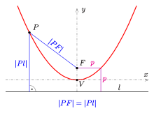
Conic sections as a locus of points
A parabola can be defined as the curve created by focal point F and directrix line l and all points P, such that the distance from P to F is equal to the distance from P to the line l .
That is, PF = Pl

Slide 6
We can mathematically define conic sections (in the Euclidean plane) in a couple of ways Note: many of the applications of conics come from their 3-dimensional analogs In Math League, we study the 2-dimensional Cartesian planar conics
As a locus of points
Using definitions of distance
Using the idea of eccentricity and distance from focal point to directrix
Algebraically
Conic sections are planar curves that fit the definition
Ax² + Bxy + Cy² + Dx + Ey + F = 0 where A, B, and C not all zero

Slide 7
Conic sections as a locus of points Using the idea of eccentricity and distance from focal point to directrix
Define a point F to be the focal point
Define a line L to be the directrix
Define a point P to be on the conic
P is on the conic if the distance FP divided by the distance LP = constant.
That is, $\frac{FP}{LP}=e$
This is constant is known as the eccentricity, e, of the conic.
If e = 0, the conic is a circle (the limiting case of an ellipse)
If 0 < e < 1, the conic is an ellipse
If e = 1, the conic is a parabola
If e > 1, the conic is a hyperbola

Slide 8
Let’s demonstrate how eccentricity can be use to create a parabola special conic graph paper

Slide 9
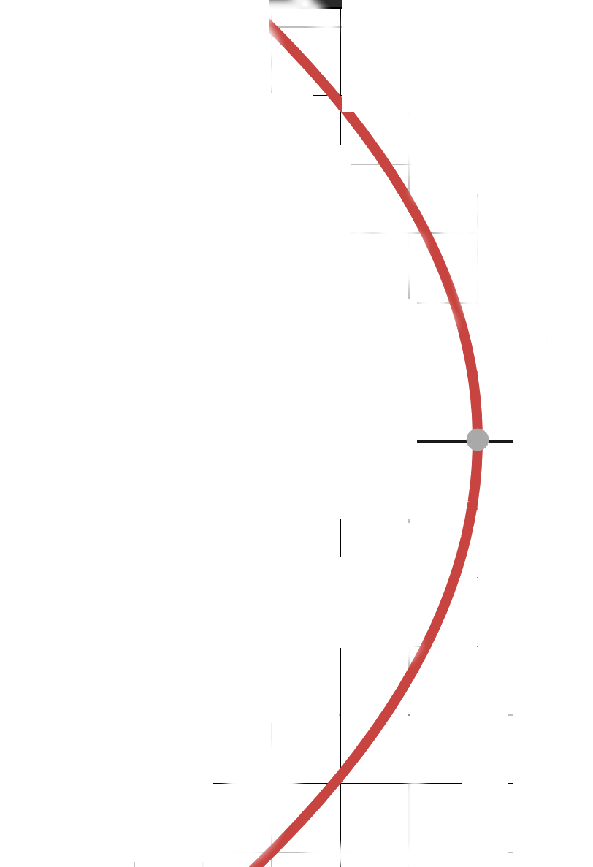
Finding a parabola using
the idea
of eccentricity
5
4
5
4
e = 1
3
3
F₁
P
F₁P/LP = 1
L
Parabola!

Slide 10
We can mathematically define conic sections (in the Euclidean plane) in a couple of ways Note: many of the applications of conics come from their 3-dimensional analogs In Math League, we study the 2-dimensional Cartesian planar conics
As a locus of points
Using “common” definitions of distance
Using the idea of eccentricity and distance from focal point to directrix
Algebraically
Conic sections are planar curves that fit the definition
Ax² + Bxy + Cy² + Dx + Ey + F = 0 where A, B, and C not all zero

Slide 11
Algebraic formula from Locus of Points definitions: Parabola (focus at (a,b)) “the distances from P to the focal points is equal to the distance from P to the directrix”

Slide 12
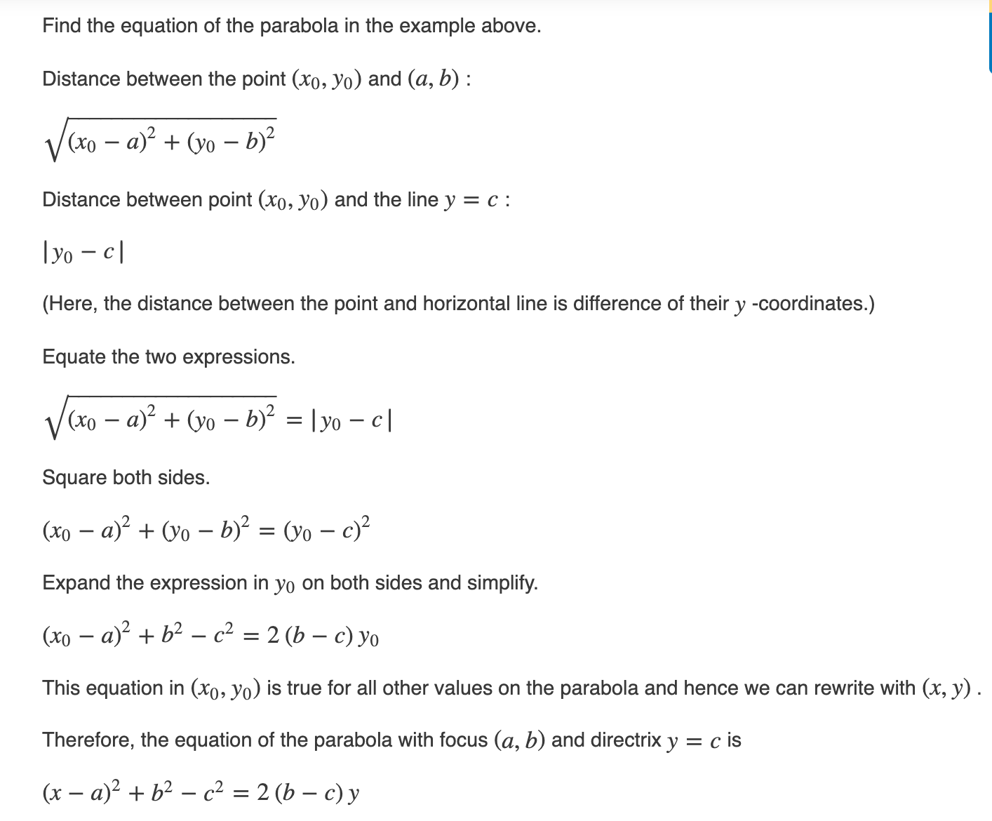
Algebraic formula from Locus of Points definitions: Parabola (focus at (a,b)) “the distances from P to the focal points is equal to the distance from P to the directrix”
Directrix at y = c

Slide 13
Potential math team problem ( is there another way? )
Find the equation of a parabola with focus at (–1, 3) and directrix at y = 5
(x – –1 )²+ 3² – 5² = 2(3 – 5)y
(x + 1)² – 16 = –4y
$\frac{−\left(x+1\right)2}{4}+4$ = y

Slide 14
Recognizing the different conics from their algebraic definition
Ax² + Bxy + Cy² + Dx + Ey + F = 0 General form
In concert with the other terms, the term Bxy does weird things to the graphs:
it can make the conic slanted (x² – 7xy + 13y² = 4),
it can cause the graph to degenerate to a line (x² – 2xy + y² = 0),
it can create two || lines (x² – 2xy + y² = 4),
it can create intersecting lines (x² – 4xy + y² = 0),
it can cause what you think is an ellipse to be a hyperbola (x² – 7xy + 2y² = 4)
hard to predict based on the interactions with the other terms.
So for this discussion, we are going to assume B = 0. Math League rarely uses conics with a B value but we will show a couple of examples later

Slide 15
Recognizing the different conics from their algebraic definition
Ax² + Cy² + Dx + Ey + F = 0 General form, where B = 0
If A = C = 0 and D, E not both zero, the graph is a line
If A = C, the graph is a usually a circle (degenerate cases can occur depending on D, E, F… e.g x² + y² + 8 = 0)
If A ≠ C, and A and C have the same sign, the graph is a usually an ellipse
(degenerate cases can occur depending on D, E, F… e.g x² +5y² -x+y+3=0)
If A ≠ C,and A and C have the different signs, the graph is a usually a hyperbola
(degenerate cases can occur depending on D, E, F… e.g x² + 20x + 100 – y² = 0)
If A or C = 0 (but not both), the graph is a parabola (I am not aware of degenerate cases)

Slide 16
Parabola terms
Note: the latus rectum
is the entire orange segment
By definition, it is the chord through the focus
parallel to the directrix
Note: a parabola is all those points
equidistant from the focus and the directrix
Therefore, the vertex is said to be a distance
p from the focus and the directrix
2p
p
Therefore the semi- latus rectum is 2p
And the latus rectum = 4p
This value 4p is important!
p

Slide 17
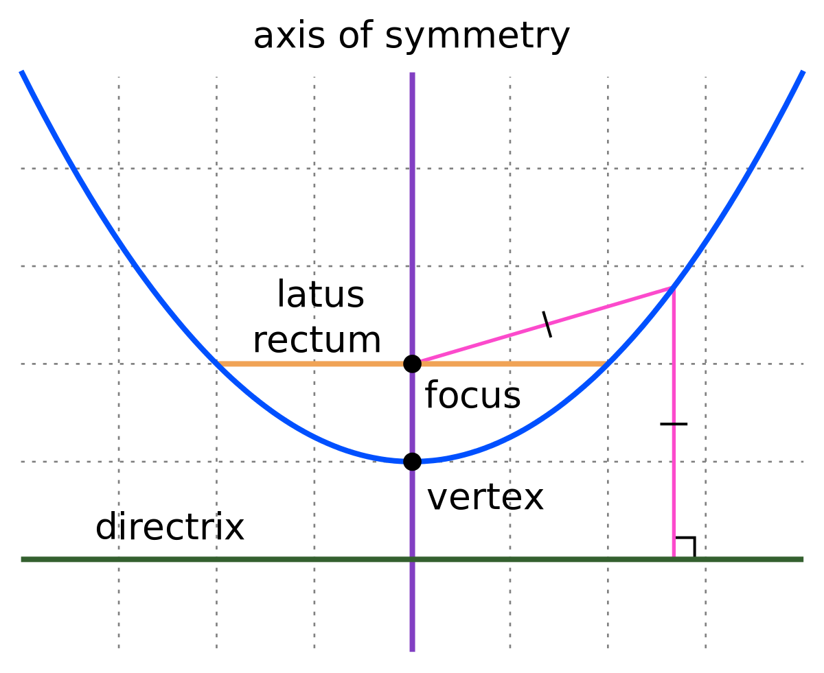
How 4p comes into play
Let’s derive the equation of a parabola
with vertex at the origin, focus F at (0,p), and
directrix L at y = –p
(0,p)
P(x,y)
In a parabola, FP = PL therefore
$\sqrt{\left(x−0\right)2+\left(y−p\right)2}$ = $\sqrt{\left(x−x\right)2+\left(y−–p\right)2}$
x² + y² – 2py + p² = y² + 2py + p²
x² = 4py
Or y = $\frac{1}{4p}$ x² which often is written y = ax²
Therefore a = $\frac{1}{4p}$
x-axis
(0,0)
p
(x,–p)
y = –p

Slide 18
Forms of a parabola
General form Ax² + Dx + Ey + F = 0 or Cy² + Dx + Ey + F = 0
Standard form y= ax² + bx + c or x = ay² + by + c
Vertex form y = a(x – h)² + k or x = a(y – k)² + h
Factored form y = a(x – r₁)(x – r₂)
Remember a = $\frac{1}{4p}$

Slide 19
Good things to know
Vertex of a parabola can be found by knowing
x-coordinate of vertex = $\frac{−b}{2a}$ or = –2pb
Quadratic formula

Slide 20
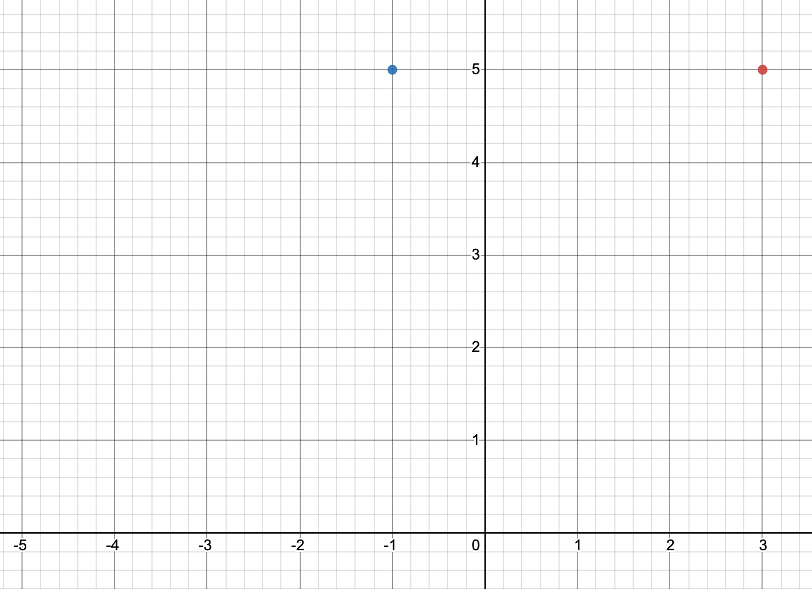
Potential Math League problem
Find the equation of a parabola that opens up if point P(3,5) is on the parabola and the point (–1,5) is the focus. Put answer in standard y = ax² + bx + c form
Sketch
F(-1,5)
P(3,5)
Since the parabola opens up
we know that the directrix must
be below the focus and || to the
x- axis.
Also the latus rectum is the segment
through focus whose length is 4p,
p being the distance from the
focus to the vertex
The semi-latus rectum is 2p

Slide 21
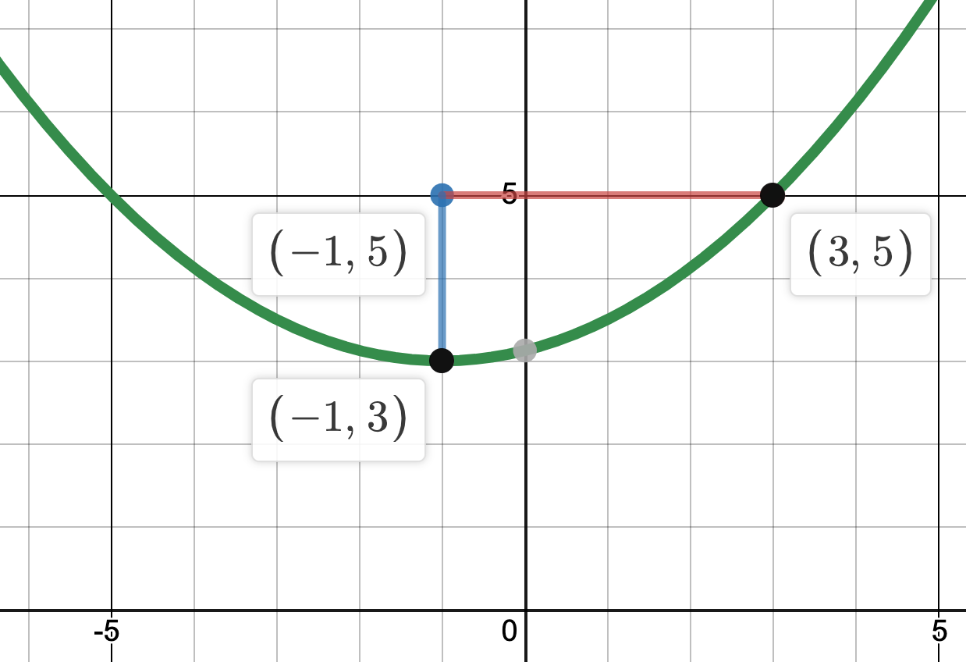
Potential Math League problem
Find the equation of a parabola that opens up if point P(3,5) is on the parabola and the point (–1,5) is the focus. Put answer in vertex y = $a$(x – h)² + k form
Sketch
Since FP = 4 = 2p, p = 2. So the vertex must
be 2 units away from F or (–1,3)
In vertex form
y = $\frac{1}{4p}$ (x – h)² + k
y = $\frac{1}{4•2}$ (x – –1)² + 2
y = $\frac{1}{8}$ (x + 1)² + 2
F
2p
P
p

Slide 22
Potential math team problem ( is there another way? )
Find the equation of a parabola with focus at (–1, 3) and directrix at y = 5
using the idea that the vertex is halfway between the focus and the
directrix leads to the fact that the vertex is at (–1,4) and that the value
for p = 1. Knowing that the parabola open down means it has a
negative a value
y = –a(x – h)² + k y = – $\frac{1}{4p}$(x – h)² + k
y $= \frac{−\left(x+1\right)2}{4}+4$

Slide 23
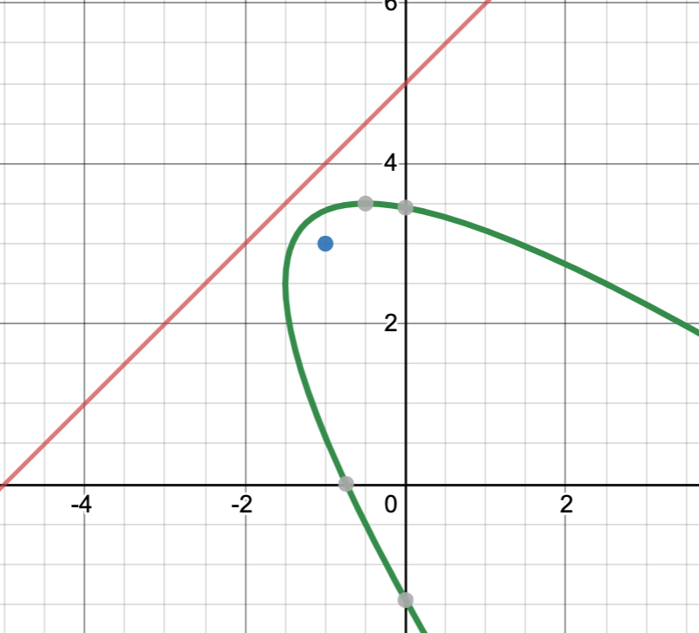
Potential math team problem
Find the equation of a parabola with focus at (–1, 3) and directrix at y = x + 5
Sketch
P(x,y)
The lengths of the two
Blue lines have to be equal
F(–1,3)

Slide 24
Potential math team problem
Find the equation of a parabola with focus at (–1, 3) and directrix at y = x + 5
The lengths of the two
Blue lines have to be equal
P(x,y)
F(–1,3)
$\frac{–x+y – 5}{\sqrt{2}}$ = $\sqrt{\left(x+1\right)2+\left(y−3\right)2}$
Through some rigorous algebra, the answer is
x² + 2xy – 6x – 2y + y² – 5 = 0
See other examples 2005 – 2006 #3 2006 – 2007 #4

Slide 25
Parabolas from the last 20+ years of MathLeague
1999 – 2000 #2
2001 – 2002 all
2002 – 2003 #2
2003 – 2004 #3
2004 – 2005 #1
2005 – 2006 #2, #3, #4
2006 – 2007 #2, #3, #4
2008 – 2009 #4
2010 – 2011 #3
2011 – 2012 #3 and #4
2012 – 2013 #2, #3, #4
2013 – 2014 #3
2014 – 2015 #1
2015 – 2016 #2
2016 – 2017 #1, #3
2017 – 2018 #1
2018 – 2019 #1, #3
2019 – 2020 #1, #2, #4

Slide 26
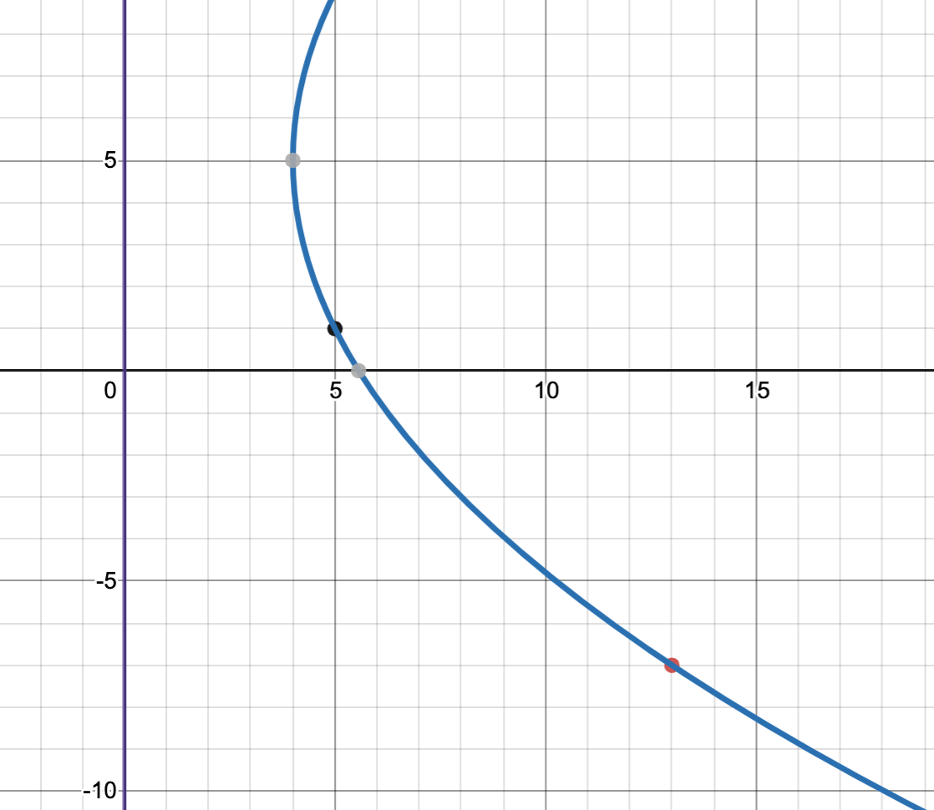
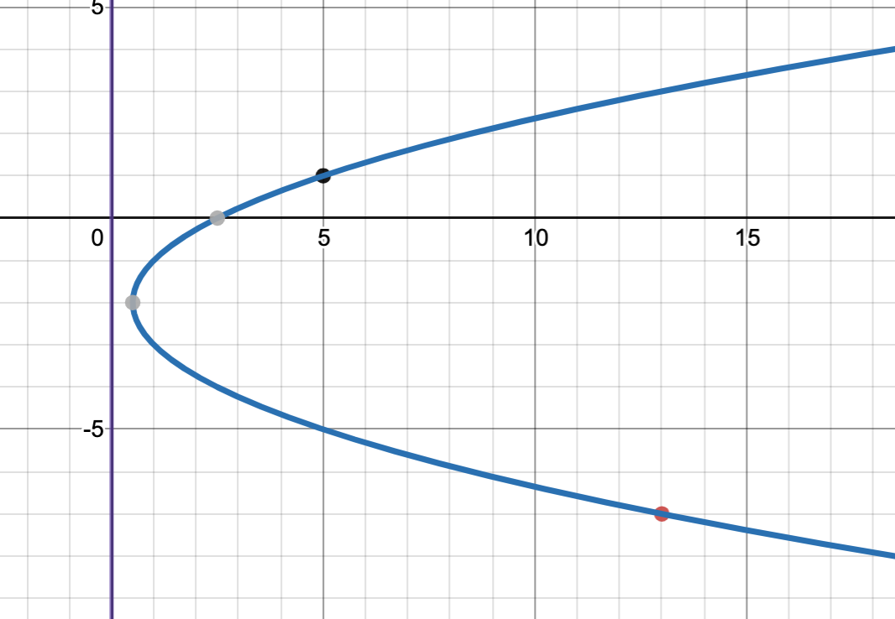
Parabolas from the last 20+ years of MathLeague
2008 – 2009 #4
Sketch
Two possibilities

Slide 27
Solution method #1: The distance from the focus (x,y) to a point has to be equal to distance from point to directrix
$\sqrt{\left(x –5\right)2+\left(y−1\right)2}$ = 5 and $\sqrt{\left(x –13\right)2+\left(y+7\right)2}$ = 13
This leads to a system 25 = x² – 10x + 25 + y² – 2y + 1
169 = x² – 26x + 169 + y² + 14y + 49
Which gives 0 = 16x – 16y – 48
Or y = x – 3 So we know the relationship in the coordinates of the focus
Substituting back $\sqrt{\left(x –5\right)2+\left(x –3−1\right)2}$ = 5
Solving for x gives x = 1 or 8
If x = 1, Focus is at (1, –2) so vertex is at (1/2, –2)
If x = 8, Focus is at (8, 5) so vertex is at (4, 5)
F(x,y)

Slide 28
Solution method #2: The distance from the vertex to the directrix is equal to the x-coordinate of the vertex = p
F(x,y)

Slide 29
This is the end of part four
In separate PowerPoints, we will examine each conic separately, working on the details of each particular conic and doing more examples from the Math League canon

